Slide 1
Is Your Program Competency-based? Could it Be?
Jason R. Frank MD MA(Ed) FRCPC
Vice-Chair, Dept. of EM, UOttawa
Director, Specialty Education
Royal College of Physicians & Surgeons of Canada

Slide 2
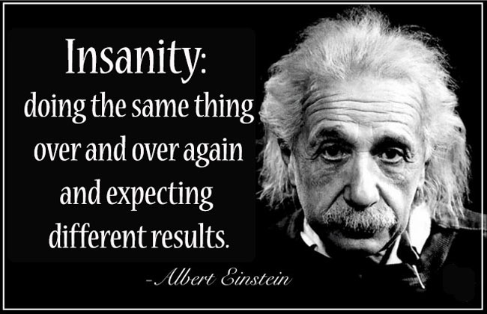

Slide 3

This session:
CBME:
Why?
What?
How?

Slide 4
This Session…
Define CBME to a colleague
Define “competency”, “milestone”, and “EPA”.
Describe the van Melle 5-Element Framework
Consider the implications for your program

Slide 5

@drjfrank

Slide 6

Discussion:
Based on your experiences as an educator, how would you describe “Competency-based Medical Education” (CBME)?

Slide 7

What is CBME?

Slide 8

Competency-based Education:
“What are the abilities needed of graduates?”
Notes:
CBME implies that outcomes—the defined abilities needed of graduates—are the central organizing principle. Teaching methods, even some traditional knowledge areas, are only included if they contribute to the ultimate outcome of the program.

Slide 9

Competence = Time?
X

Slide 10

Competence = Achievement

Slide 11
So then, What is Competency-Based Health Professions Education?
…an outcomes-based approach to the design, implementation, assessment and evaluation of a medical education program using an organizing framework of competencies
Notes:
CBME therefore is an outcomes-based approach to the design, implementation, assessment and evaluation of a medical education program using an organizing framework of competencies

Slide 12

CBME: A Global Movement
Netherlands
USA
Singapore
Australia
Canada

Slide 13

CBME: WHY?

Slide 14

Criticisms of Modern Med Ed:
Diagnosis:
“The Ad-Hoc Model of Med Ed”
How can we ensure your graduates are competent in all needed domains…?
Notes:
Put another way, “How can we ensure that our graduates are competent in all needed domains…?”

Slide 15

Feedback From Faculty…
Time pressured – clarify roles for efficiency
Supervision
Ad hoc teaching
Feedback can be painful or risky
Long generic assessment forms are ~useless
Concerns about learner progression & expectations
Concerns about graduates

Slide 16

“Rater Range Restriction”
“Pleasant”
“Read More”

Slide 17

Little Observation
-Holmboe

Slide 18
Clinical Teaching,
Assessment & Feedback
Generic
Rating scales
Ad-hoc
Residents’ reaction
Supervision

Slide 19

Graduates with Lacunes

Slide 20
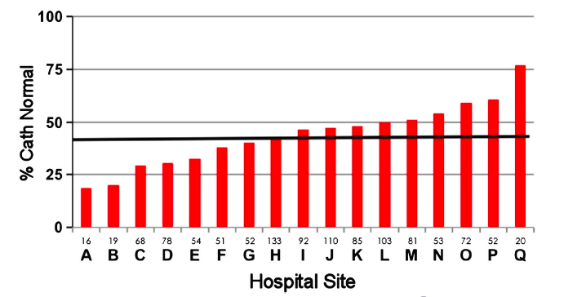
Variations in MD Practice
Levitt K. Am Heart J 2014

Slide 21

Phases of Medical Education
We need a model for the 21st century
We need to respond to calls for change in graduate competencies
We need to ensure graduates have all the essential competencies
We need to move to a true continuum & progression of competence
We need to move away from time-based credentials

Slide 22
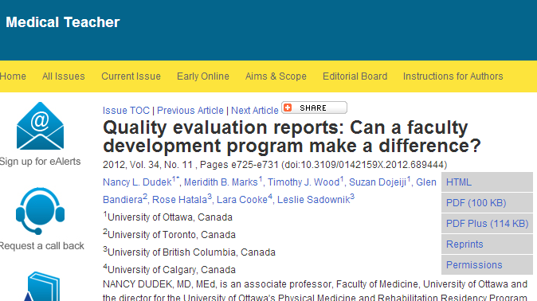

Difficulties with Assessment
Dr Nancy Dudek

Slide 23
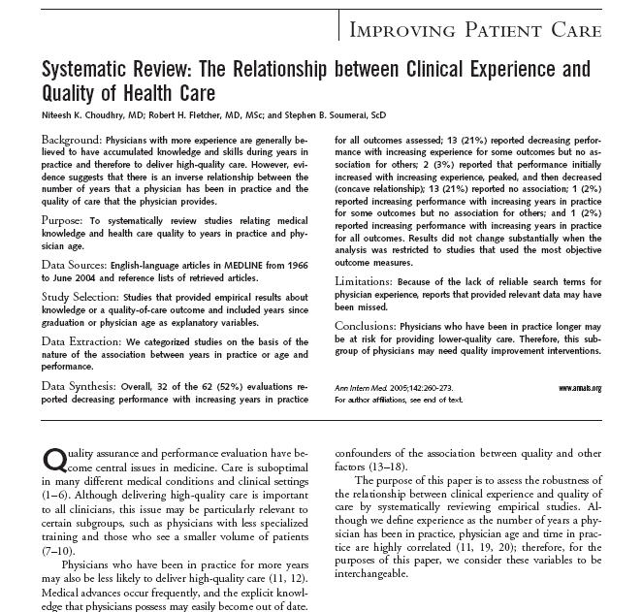
Learning in Practice
Notes:
In a metaanalysis of dyscompetent physicians in the Annals of IM, it was found MD competence tends to fade over time.
And licensing authorities say they are most worried about the solo male, older practitioner.

Slide 24

Diagnosis:
The Ballistic Model of Med Ed

Slide 25
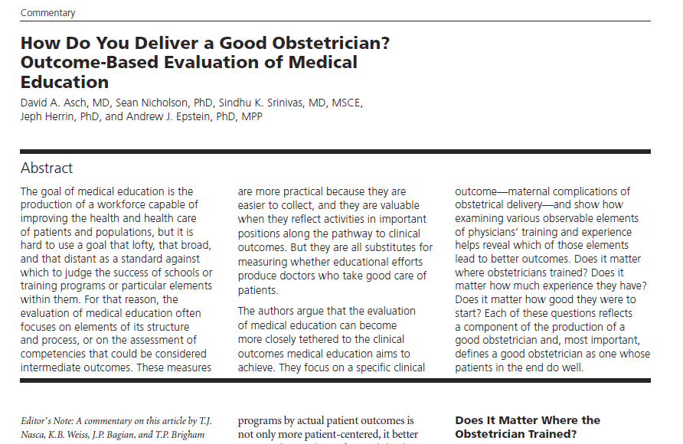
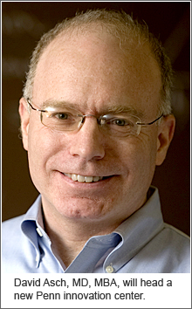

Slide 26
Themes in Current Training:
Based on time spent, not ability
Trainees unprepared at stages
Unclear progression of expertise
Weak assessment/failure to fail
Assessment can feel bogus, useless
Concerns about patient harm
Missing content
Disempowered Trainees

Slide 27

Diagnosis:
The “Tea Bag Model” of Med Ed
Is there a better way to ensure competence than just time spent?
Notes:
In my view, a fundamental threat to the future of medical education is this criticism, called the “tea bag model”: it argues that medicine tends to credential physicians based on the time spent in training, not based on their achievement of necessary abilities.
Our medical education systems of the 20th century are no longer “good enough”. We need to do better.

Slide 28
CBME: WHY?

Slide 29

The CBME “Toolkit”

Slide 30
Competency / Competencies
An observable ability of a health professional
  Reflects a spectrum
  Integrates multiple components such as knowledge, skills, values, and attitudes
  Multiple competencies can be combined
  Measureable with respect to a defined outcome;
Notes:
In the CBME approach, medical education is organized around “competencies”, and not just scientific medical knowledge as in our traditional approach.

Slide 31
Defining Milestones & EPAs
Milestones:
The abilities expected of a health professional at a stage of development
(e.g. intubate an airway under supervision)
Entrustable Professional Activities (EPAs):
The key tasks of a discipline that a practitioner needs to be able to perform
(e.g. run a clinic)

Slide 32

Milestones in Medical Education: Progression

Slide 33

Key concept of EPA’s & Milestones:
Progression
I’m surprised you can’t
do that at this stage in
your training

Slide 34
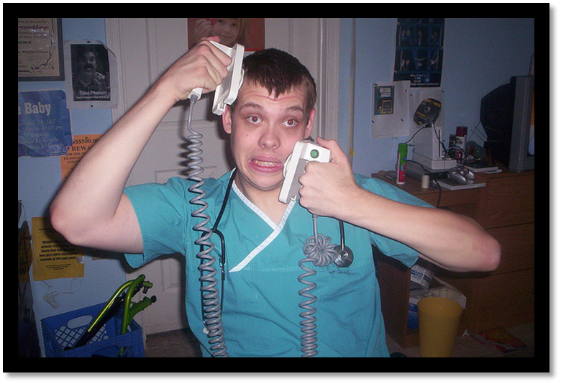
Key Concept in EPAs: Entrustment
“What can I safely delegate with
indirect supervision?”

Slide 35

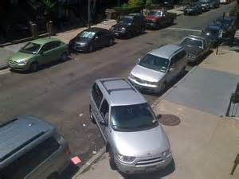

Examples of EPAs
In the real world
  Teenager on an errand
In medicine
Run a code

Slide 36
Data…Analytics

Slide 37
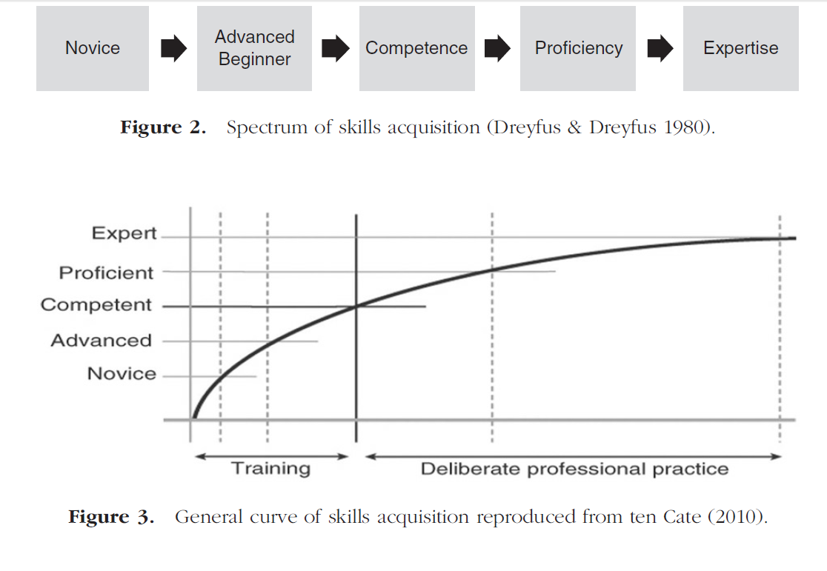
Conceptual framework for performance assessment. Khan and Ramachandran, Medical Teacher 2012; 34: 920-928
Notes:
Competence is about performance – the right thing, for the context at the right time

Slide 38
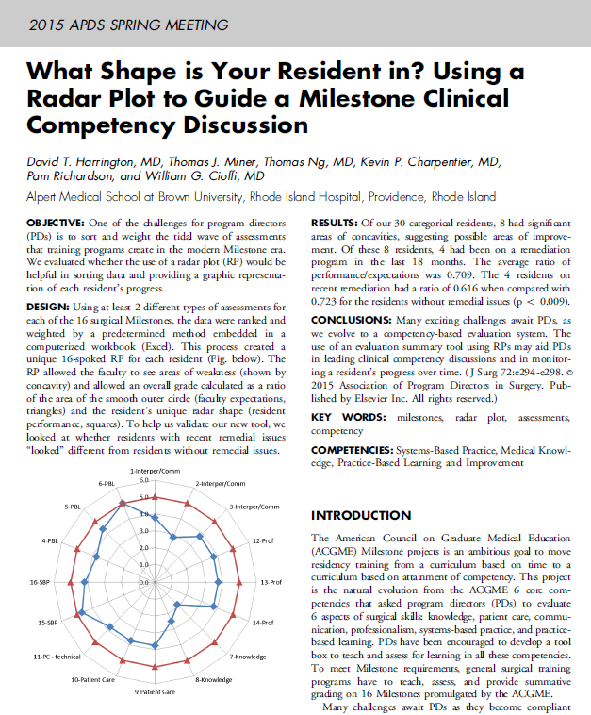

Slide 39
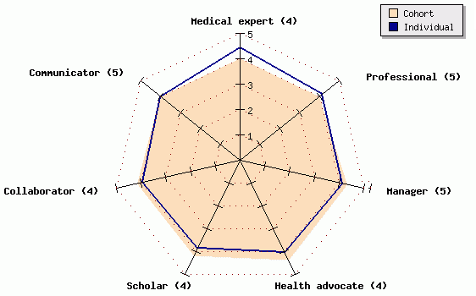
Maastricht Electronic portfolio
(ePass)
Comparison between the score of the student and the average score of his/her peers.

Slide 40
So, Is Your Program CBME?

Slide 41
A Spectrum of CBME Innovations
Van Melle’s Components of a “CBME” Curriculum:
Outcomes defined as competencies
Competencies organized as a progression
Tailored sequence of learning experiences
Competency-focused teaching methods
Programmatic assessment for learning
Notes:
Linda

Slide 42
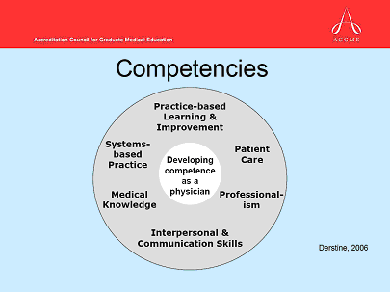

1. Outcomes Defined as Competencies
Carefully chosen abilities for those who successfully complete the curriculum
Observable
Practical
Relevant to practice expertise
Relevant to societal needs

Slide 43

2. Competencies Organized as a Progression

Slide 44
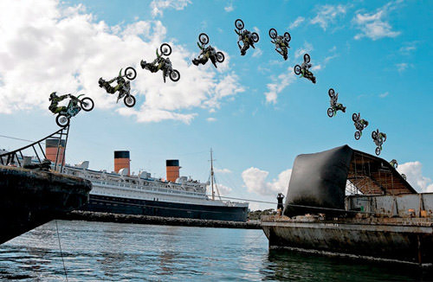
3. Tailored sequence of learning experiences
Utility rules
Ask: “what competencies can be acquired with this experience”
Not always = service provision

Slide 45

4. Competency-focused teaching methods
Active learning of sequenced priority content
Immersion
Deliberate practice
Coaching & high quality feedback

Slide 46
5. Programmatic Assessment that promotes Learning
Emphasis on workplace observation
Focused on tasks performed
Multiple observers
Multiple methods
Entrustment
Curation
Collation
Decision-framework & benchmarks

Slide 47
Assessment of EPA Achievement
EPA Observation Ratings
Point in time
Single Observer
Specific context
Competence
EPA Achievement
Multiple times
Multiple Observers
Multiple contexts
Slide: Dr. K Caverzagie

Slide 48
A Spectrum of CBME Innovations
Van Melle’s Components of a “CBME” Curriculum:
Outcomes defined as competencies
Competencies organized as a progression
Tailored sequence of learning experiences
Competency-focused teaching methods
Programmatic assessment for learning
Notes:
Linda

Slide 49
Transformational CBME:
Competence by
Design Project

Slide 50

Notes:
Key messages:
After several years of work, the Royal College is officially launching the CanMEDS 2015 Framework on Saturday morning.
Remember though, the CanMEDS project is part of the broader CBD initiative …. We’re building toward an improved system that facilitates all of the improvements that Dr. Harris outlined earlier
Goal of the CanMEDS 2015 project specifically was to update the content for contemporary medicine and create milestones to facilitate CBME
Over the course of 2.5 years we engaged MANY partners and consulted widely
We released the Framework (and Milestones) in serial fashion over the course of 2014 to gather feedback and to adjust the content as appropriate
Our methodology was robust ….. we can all stand behind CanMEDS confidently knowing that it is valid
CanMEDS and the milestones is foundational to the rest of the plans associated with CBD. CBD is on track!
You can be confident that the Royal College’s model for CanMEDS (consultation, engagement, partnership) is the model we’re taking for CBD

Slide 51
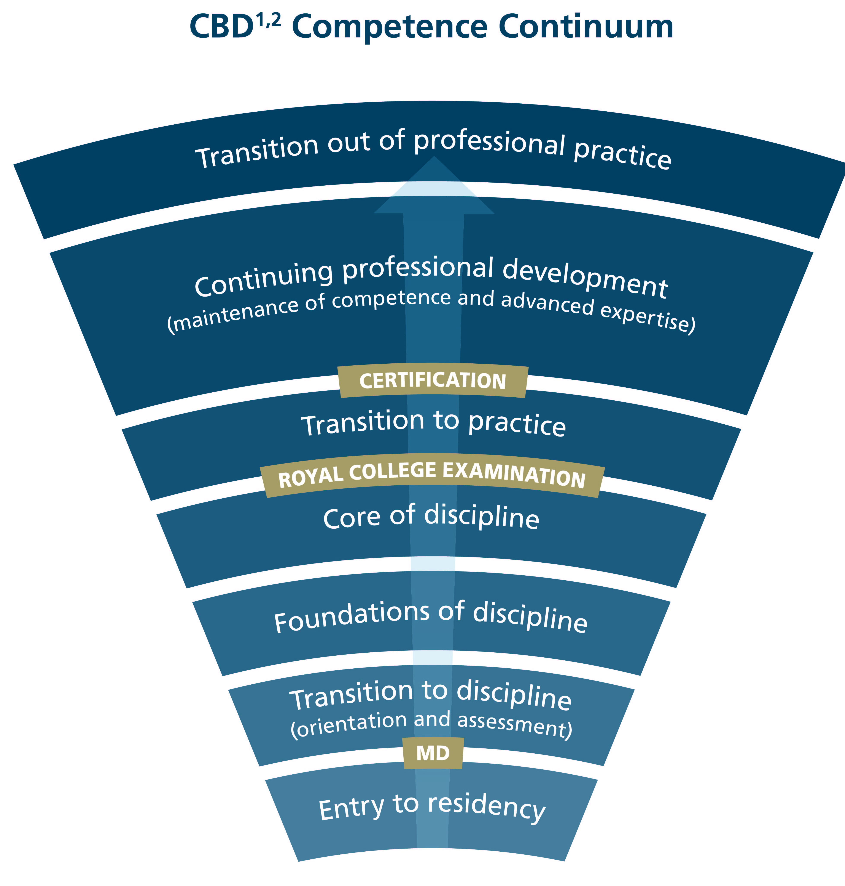
Key Elements
New CanMEDS
Stages of physician development
EPAs & Milestones
New Assessment
New Accreditation

Slide 52
Defining the stages of training

Slide 53
Next Generation Meded:
Forget:
Enter:
PGYs
Objectives
Prescriptive standards
Ad hoc ITERs
the Big Exam
“Read more”
5 years only
Stages
Milestones & EPAs
Local Flexibility
Competence Ctes
Progress testing
Focused observation
Ready to practice

Slide 54

Milestones within an EPA
Milestone
Milestone
Milestone
EPA
Typically, each
EPA integrates
multiple milestones.

Slide 55

Milestones and EPAs within Four Stages of Residency
Notes:
So, within each stage there were be several EPAs which are composed of the component milestones

Slide 56
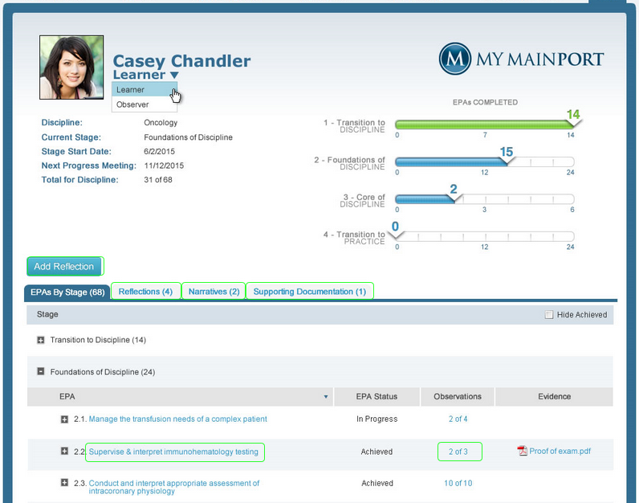
ePortfolio: Learner Dashboard

Slide 57
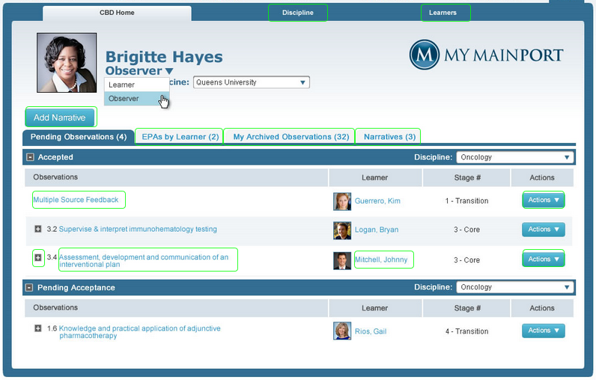
ePortfolio: Observer Dashboard

Slide 58
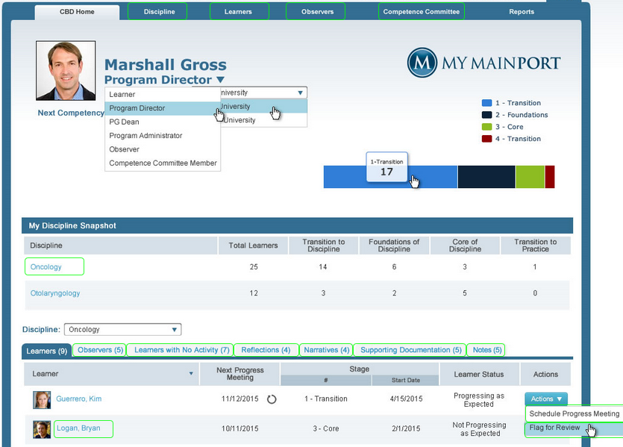
ePortfolio: PD Dashboard

Slide 59
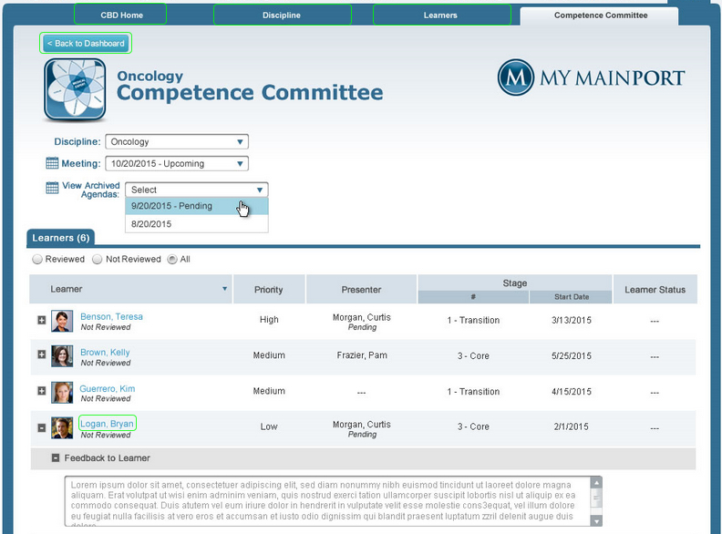
ePortfolio: Competence Committee Agenda

Slide 60
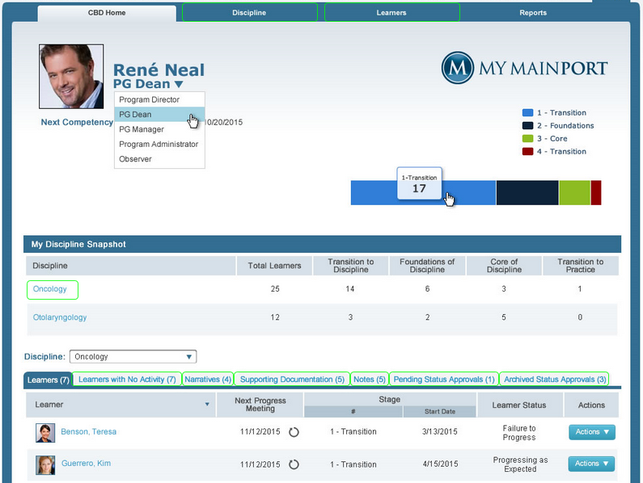
ePortfolio: PG Dean Dashboard

Slide 61

TOWARDS CBME…

Slide 62
This Session…
Define CBME to a colleague
Define “competency”, “milestone”, and “EPA”.
Describe the van Melle 5-Element Framework
Consider the implications for your program

Slide 63
Is Your Program Competency-based? Could it Be?
Jason R. Frank MD MA(Ed) FRCPC
Vice-Chair, Dept. of EM, UOttawa
Director, Specialty Education
Royal College of Physicians & Surgeons of Canada

