Slide 1
Are national assessment systems associated with improved quality of care?
John Norcini, Ph.D.

Slide 2
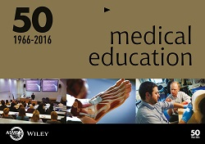
Trends in National Licensing Exams Swanson and Roberts
Increase in national licensing exams
Number and diversity of medical schools
Mobile workforce
Exams predict practice performance
Weak to moderate relationships
January 2016

Slide 3
Commentaries by Jolly and Schuwirth
Offer a number of appropriate cautions
Exams might drive the curriculum
Lack of clear-cut evidence that exams are associated with patient outcomes
January 2016

Slide 4
Aims for Today
Broaden the focus to include all national assessment programs
Challenges of research on licensure programs
Present a series of studies of certification using patient outcomes as the criteria
Describe the study data, programs, and results
Effects of recent experience and time since training
Implications for national assessment

Slide 5
Research Challenges
Relationship between national assessments and educational markers
Medical school
Postgraduate training
Other assessments
These do not speak directly to quality of care

Slide 6
Research Challenges
It is difficult to establish a relationship with quality of care
Examinees
Somewhat homogeneous to start
Especially where accreditation is effective
Examinees cannot practice without passing the exam
Research must focus on the scores of passers
Restriction of range is an issue
It limits the ability to detect sizeable effects

Slide 7
Research Challenges
It is difficult to establish a relationship with quality of care
Practice data
Difficult to acquire
Often generated long after licensure
Patients are not randomly assigned to doctors
Case mix, severity of illness…
Difficult to attribute patient outcomes to a doctor
Criteria contain errors, biases…
It limits the ability to detect sizeable effects

Slide 8
Research Challenges
In this context, there are advantages to
ECFMG certification
More heterogeneous group of examinees
Specialty certification in the U.S.
Voluntary so the unsuccessful still practice (10-20%)
Both are based on good national assessment systems that have been in place for decades
Growing repositories of patient data

Slide 9
Research Challenges
Present work done with ECFMG and specialty certification using patient outcomes as the criteria
Complementary to other research
Licensure
Outside the US
Other quality measures
Physician volume
Process of care (Tamblyn)
ECFMG Certification
Licensure
Specialty Certification

Slide 10
Sources of Physician Data
Sources of data about physicians
AMA Masterfile
Basic information on all physicians in the US
Specialty certification
ECFMG
Physicians who are international medical graduates
American Board of Internal Medicine
Information on physicians who sought IM certification
ECFMG Certification
Licensure
Specialty Certification

Slide 11
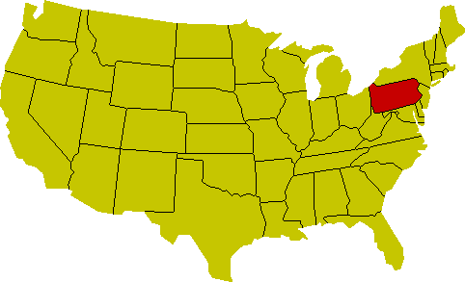
Source of Patient and Hospital Data
Pennsylvania Healthcare Cost Containment Council
Collects all hospitalizations
Administrative and clinical data (probability of death on admission)
Creates report cards for doctors and hospitals
Shares the data with research entities

Slide 12
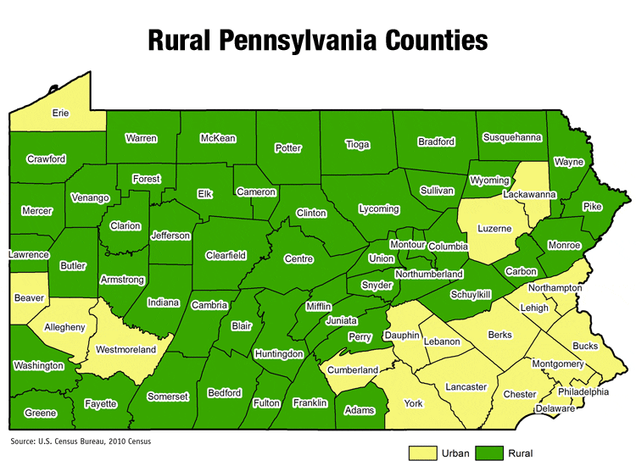
Source of Patient and Hospital Data
PA is the 6th most populous state in the US
33rd largest in size
48 of the 67 counties are rural
27% of the population
Many IMGs

Slide 13
Analyses
Analyses adjusted for
Patients clustered within doctors and doctors within hospitals
Patient, doctor, and hospital characteristics
Potential confounders-biases like hospital
Generalized estimating equations
“Statistics show that of those who contract the habit of eating, very few survive”
GB Shaw

Slide 14
Educational Commission for Foreign Medical Graduates
Certification is required for graduates of non-US medical schools who want US postgraduate training
20-25% of trainees and practicing doctors
Motivation for ECFMG certification
Inability to make judgments about the quality of non-US medical schools
Desire for a merit-based entry system

Slide 15
Requirements for ECFMG Certification
Basic Medical Training
Completed in a WDMS school
Transcript and Diploma
Exams
USMLE Steps 1 & 2
Verified Credentials

Slide 16
Questions Addressed
Are there differences between IMGs and USMGs?
If certification works, there should not be
Are higher scores associated with better patient outcomes?
Does recent experience and/or time since graduation matter?
“I wish I had an answer to that because I'm tired of answering that question.”
Y Berra

Slide 17
Does ECFMG certification work?
Doctors (N=6113) | Hospitals (N=184) | Patients (N=244,151)
Self-identified FM, IM, CV | All | Congestive heart failure Acute myocardial infarct
Specialty certification Cardiologist Years since graduation Patient volume USMG/USIMG/non-USIMG | Rural location Patient volume | Probability of death on admission In-hospital mortality
Health Affairs, 2010

Slide 18
Does ECFMG certification work?
Study focus
No difference between IMGs and USMGs
Non-USIMGs decreased RR by 9% against USMGs and 15% against USIMGs
Experience-related
Recent individual volume reduced RR by 1% for every 10 hospitalizations
Time since graduation increased RR by 6% for every decade
Health Affairs, 2010

Slide 19
Does the exam work?
Doctors (N=2525) | Hospitals (N=173) | Patients (N=60,958)
IMGs who were self-identified FM, IM, CV | All | Congestive heart failure Acute myocardial infarct
Step 2CK scores Cardiologist Specialty certification Years since graduation (>1992) Patient volume USIMG | Rural location Patient volume | Probability of death on admission In-hospital mortality
Academic Medicine, 2014

Slide 20
Does the exam work?
Study focus
Each score SD was associated with a 4% decrease in RR for mortality
Experience-related
Time since graduation was not statistically significant (restricted range)
Recent individual volume reduced RR by 1% for every 10 hospitalizations
Academic Medicine, 2014

Slide 21
Specialty Certification
Specialty Boards (1916-)
Created by the specialty societies and AMA
Set standards for training and exam performance
Participation voluntary
Most physicians attempt certification and 80-90% become certified

Slide 22
Requirements for Specialty Certification
Good Standing
Valid and unrestricted medical license
Exams
Written exam (all Boards)
Oral exam (most Boards)
Training
US Medical School or ECFMG
Accredited postgraduate training

Slide 23
Questions Addressed
Are there differences in patient outcomes between certified and uncertified physicians?
Certification status for internists, family physicians, and cardiologists
Certifying exam performance for internists and cardiologists
Certification status for thoracic surgeons
Does recent experience and/or time since graduation matter?

Slide 24
Does specialty certification work?
Doctors (N=4546) | Hospitals | Patients (N=28,756)
Self-identified FM, IM, CV | All | Acute myocardial infarct
Specialty certification Cardiologist Years since first exam Patient volume | Rural location Advanced cardiac care | Probability of death on admission In-hospital mortality
Academic Medicine, 2000

Slide 25
Does specialty certification work?
Certification
Certification had a statistically significant relationship with mortality
Relative risk reduction of 15% and absolute reduction of 1.5-2%
Experience
Recent individual volume reduced RR by 6% for every 10 hospitalizations
Time since graduation increased RR by 6% for every decade
Academic Medicine, 2000

Slide 26
Do specialty exams work?
Doctors (N=2277) | Hospitals | Patients (N=16,629)
Self-identified IM, CV | All | Acute myocardial infarct
Specialty certification Cardiologist Years since first exam Patient volume | Rural location Advanced cardiac care | Probability of death on admission In-hospital mortality
Medical Education, 2002

Slide 27
Do specialty exams work?
Exam-related
Certification had a statistically significant relationship with mortality
Relative risk reduction of 19% and absolute reduction of 2%
Experience-related
Time since first IM exam was not statistically significant
Recent individual volume was not statistically significant
Medical Education, 2002

Slide 28
Does it work for surgeons too?
Operator (N=289) | Attending (N=2654) | Hospitals (N=70) | Patients (N=114,751)
Self-identified thoracic surgeons |  | All | CABG Valves
Certified thoracic surgeon Years since medical school Patient volume IMG Operator-attending match | Certified thoracic surgeon Certified cardiologist Years since medical school Patient volume IMG | Rural location Patient volume | Type of admission Probability of death on admission In-hospital mortality
Medical Care, 2013

Slide 29
Does it work for surgeons too?
Study focus
Operating-attending match was associated with a 38% decrease in RR
Experience-related
Operator
Time since graduation increased RR by 9% per decade
Recent individual volume reduced RR by 1% for every 20 procedures
Board-certified thoracic surgeon decreased RR by 18%
Attending physician
Time since graduation lowered RR by 7% per decade
Medical Care, 2013

Slide 30
Declining ability or failure to keep up?
MOC examination
Items classified by a group of experts, with access to library resources
‘Stable’ (26%)
‘Changing’ (47%)
‘New’ (27%)
Examinees (N=1947)
Classified into five groups by when they finished training
Rime Conference Proceedings, 1988

Slide 31
Declining ability or failure to keep up?
Results
Scores on new and changing knowledge items decreased as time since training increased
Scores on stable knowledge showed no pattern and smaller changes
Rime Conference Proceedings, 1988

Slide 32
Summary and Implications
National assessment programs are associated with patient outcomes
Four common conditions
Notable effect sizes
Exam is an effective part of the programs
Programs are effective screens that support quality of care
“A judge is a law student who marks his own examination papers.”
HL Mencken

Slide 33
Summary and Implications
Overall, physician performance declines with time since training
Independent of recent experience
Probably a result of not keeping up
More research needed
Maintenance of competence is essential
“We learn from experience that men never learn from experience”
GB Shaw

