Slide 1
Transformation of Medical Education in Canada
V International Congress of Medical Education
Friday June 17 2016, 11:30
Cancun, Mexico
Dr. Geneviève Moineau, President and CEO,
Association of Faculties of Medicine of Canada

Slide 2
Social Accountability Mandate World Health Organization
"[Medical Schools have] the obligation to direct their education, research and service activities towards addressing the priority health concerns of the community, region, and/or nation they have a mandate to serve. The priority health concerns are to be identified jointly by governments, health care organizations, health professionals and the public."

Slide 3
Responsabilité sociale au Canada 2001
AFMC avec Santé Canada (ministère fédéral)

Slide 4
www.afmc.ca/fmec/

Slide 5
“The Future of Medical Education in Canada” MD Recommendations
Address Individual and Community Needs
Enhance Admissions Processes
Build on the Scientific Basis of Medicine
Promote Prevention and Public Health
Address the Hidden Curriculum

Slide 6
“The Future of Medical Education in Canada” MD Recommendations
Diversify Learning Contexts
Value Generalism
Advance Inter- and Intra-Professional Practice
9. Adopt a Competency-Based and Flexible Approach
10. Foster Medical Leadership

Slide 7
Enabling Recommendations
I: Re-Align Accreditation Standards
II: Build Capacity for Change
III: Increase National Collaboration
IV: Increase the Intelligent Use of Technology
V: Enhance Faculty Development
Notes:
7

Slide 9
FMEC PG Recommendations
1: Ensure the Right Mix, Distribution, and Number of Physicians to Meet Societal Needs 2: Cultivate Social Accountability through Experience in Diverse Learning and Work Environments 3: Create Positive and Supportive Learning and Work Environments
4: Integrate Competency-Based Curricula in Postgraduate Programs 5: Ensure Effective Integration and Transitions along the Educational Continuum

Slide 10
FMEC PG Recommendations
Rec 6: Implement Effective Assessment Systems Rec 7: Develop, Support, and Recognize Clinical Teachers Rec 8: Foster Leadership Development Rec 9: Establish Effective Collaborative Governance in PGME Rec 10: Align Accreditation Standards

Slide 11
Physician Resource Planning Rec 1
Physician Resource Planning Advisory Committee
Government mandated and funded
Joint venture of the Federal/Provincial/Territorial Committee on Health Workforce (CHW) and the AFMC
Membership includes government and academics working to develop
Projection model 20 years into the future
Confirm method for ongoing collaboration
Inform all those in the system

Slide 12
CanMEDS 2015 Royal College

Slide 13
CanMEDS 2015 Competencies Rec 4 & 8
Enhanced framework – CanMEDS 2015
Aligned with CBME approach and milestones
Major change from ‘Manager’ to ‘Leader’ role
Describes the engagement of all physicians in the health care system
Encompasses collaborative leadership and management skills

Slide 15
AFMC EPA Transition to Residency Rec 4 & 5
EPA = Entrustable Professional Activities
Set of core skills expected of every medical student upon graduation
Pan-Canadian list derived from 13 AAMC EPAs
Adapted for a Canadian context
Landed on 12 Canadian EPAs
Approved by all Deans of Medicine of Canada for implementation in all Canadian schools.

Slide 16
AFMC EPAs

Slide 17
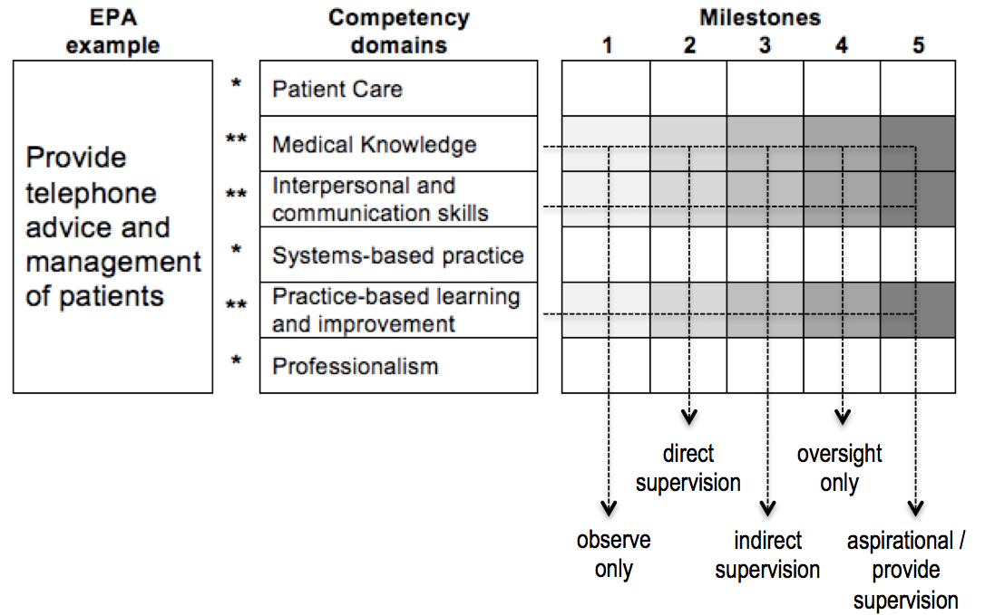
CBME, EPAs and Milestones - How do they all relate?
EPAs: what we do
Competencies: KSAs we need to be competent – person-descriptors
Milestones (observable behaviours) : how we get there
Ten Cate et al., Med Teach AMEE guide 99, 2015

Slide 18
Residency Education Collaborative Governance Council (Rec 9)
Membership includes senior leaders from major Canadian medical education organizations, learner groups, government and a public member
Mandate: Integrates the multiple PGME stakeholders to work collaboratively to achieve efficiency, reduce redundancy and provide clarity on strategic directions and decisions for PGME in the best interest of society, learners and the health system

Slide 19
Accreditation Alignment Rec 10
Align accreditation standards and processes across the learning continuum
5 committees, 6 organizations involved
Including Data requirements across organizations with development of a shared Accreditation Management System (AMS)
Striving to find the right balance between processes and outcomes

Slide 20
Conclusion
Questions/Comments?

Slide 21
Just Really Lucky
Universal Health Care System
Publically Funded Medical Education System
All medical schools part of a University Faculty
All residency programs University based
Fewer organizations than many countries
Nice people who usually want to collaborate
Lots of friendly neighbors willing to help
And now a government who seems to care

