Slide 1

Innovations and Emerging Areas in Canada
International Congress of Medical Education
Fraday June 17 2016, 10 AM – Cancun, Mexico
Dr. Geneviève Moineau, President and CEO,
Association of Faculties of Medicine of Canada

Slide 2
Innovations and Emerging Areas
Workforce Planning with government
Ongoing focus on Family Medicine
Distribution of Medical Education
Leadership in Medical Education
Increased Focus on indigenous education

Slide 3
Social Accountability Mandate
World Health Organization
"[Medical Schools have] the obligation to direct their education, research and service activities towards addressing the priority health concerns of the community, region, and/or nation they have a mandate to serve. The priority health concerns are to be identified jointly by governments, health care organizations, health professionals and the public."

Slide 4
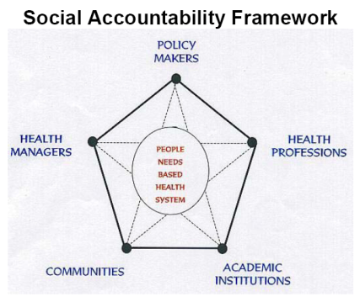

Slide 5

Responsabilité sociale au Canada 2001
AFMC avec Santé Canada (ministère fédéral)

Slide 6





www.afmc.ca/fmec/

Slide 7




Slide 8
Pan Canadian Physician Resource Planning
Physician Resource Planning Advisory Committee
Deputy Minister of Health mandated and funded
Joint venture of the Federal/Provincial/Territorial Committee on Health Workforce (CHW) and the AFMC
Membership also includes representatives from academic medicine including learners
To determine the right number, mix and distribution of physicians to meet societal needs (FMEC PG Rec 1)

Slide 9

Family Medicine as a Specialty

Slide 10
Province of Québec
Too many sub-specialists, not enough family physicians
We cannot afford to train doctors who do not respond to the needs of the population.
Québec government proposes a reversal of the traditional family medicine vs. specialty ratio to obtain, respectively, 55% family physicians and 45% specialists, and that, as of 2017.

Slide 11
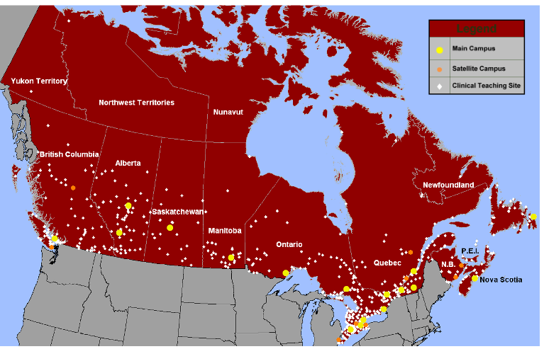
LÉGENDE
Campus principaux
Campus satellites
Emplacements d’enseignement clinique
Notes:
LÉGENDE
Campus principaux
Campus satellites
Emplacements d’enseignement clinique
Taken from AFMC report “Mapping UGME in Canada” 2010
Shows the scope of DME practices across Canada

Slide 12

CanMEDS 2015

Slide 13
CanMEDS 2015 – Leader Role
Describes the engagement of all physicians in shared decision-making for the health care system
Encompasses collaborative leadership and management skills
Leader as team player

Slide 14
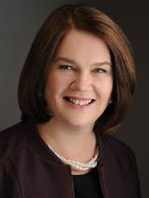
New Government, New Opportunities
Dr Jane Philpott
Federal Minister of Health

Slide 15
Every med school should admit one Inuit student this fall: federal health minister
Written by Pat Rich on June 6, 2016
OTTAWA | Federal Health Minister Dr. Jane Philpott wants to see every Canadian medical school admit at least one Inuit student this fall.
“Many of our faculties of medicine already have programs promoting the admission of indigenous physicians—not specifically Inuit (but all First Nations peoples)—and this is part of our social accountability mandate,” said Dr. Geneviève Moineau, president and CEO of the Association of Faculties of Medicine of Canada, which serves as the national voice of the Canada’s 17 medical schools. Dr. Moineau, who was at the conference added that she spoke to the minister about this right after her speech and looks forward to continuing the discussion on this topic.
Dr. Alika Lafontaine, president of the Indigenous Physicians Association of Canada, who was also at the conference said Dr. Philpott made some very good points about the need for Inuit physicians, and particularly that proportional representation is an important element of health equity.

Slide 16

Conclusion
Questions/Comments?
AFMC.ca

Slide 17
A Canadian Consensus on Core Competencies for Transition from Medical School to Residency
V International Congress of Medical Education
June 2016 – Cancun, Mexico
Dr. Geneviève Moineau, President and CEO,
Association of Faculties of Medicine of Canada

Slide 18


