Slide 1
Importance of accreditation and adjustments to the various political, social and economic changing environments
Trudie E Roberts
Director Leeds Institute of Medical Education, UK and AMEE President

Slide 2
What is the problem?

Slide 3
World population and Numbers of medical professionals

Slide 6
The human side….

Slide 7
Primum non nocere: patient safety and assuring medical professional competence for a global workforce

Slide 8
Regulation of Doctors in the UK
All doctors wishing to work in any capacity in the UK, whether in the NHS or elsewhere, must be registered and licensed to practise with the GMC.

Slide 9
The purpose of the GMC…..
…is to protect, promote and maintain the health and safety of the public by ensuring proper standards in the practice of medicine.

Slide 10
Functions of the GMC

Slide 11
Regulation and quality assurance
The GMC through its system of quality assurance of basic medical education inspects all medical schools in the UK
From 2012 there has been a programme of revalidation for all doctors

Slide 12
The population of doctors in the UK
In 2014 267,168 doctors on the medical register
236,908 had a licence to practise

Slide 13
Four largest specialty groups by PMQ

Slide 14
Fitness to Practise 2014
8884
complaints
Warning
79
236,908
doctors in
practice
2750
GMC
investigations
Conditions
51
862
not GMC
593
to employer
319
hearings
Advice
213
22
erased/
suspended
No action
1428

Slide 15
Referrals to the GMC
GMC FtP referrals 2010-2014
70 -85% male
49% doctors >50yrs old
77% poor communication cases were about males
44% cases non- UK graduate (22% EEA)
59/1000 doctors were about non-UK graduates
Cf 38/1000 doctors who were UK graduates

Slide 16
Regulation of Doctors in Europe
Quality assurance of medical education is shared – medical councils, local authorities and ministries
Regulation is often decentralised
Revalidation is at different stages
Rand report for GMC
2009

Slide 17
Regulation outside Europe
Rand Report: Egypt, India, Nigeria, Pakistan, South Africa
Registration is mandatory
All countries have a code of ethics
All have FtP processes
Core set of requirements for registration
Nigeria compulsory CPD or license is not renewed
India some parts reapply for registration but admin only

Slide 18
New graduate issues
Quality assurance across UK Universities
English language ability of EEA graduates at the start of training (F1)

Slide 19
New UK Medical Licensing Assessment
Coming in 2022

Slide 20
GMC registration requirements
Within the EEA there is mutual recognition of equivalent training and qualifications.
Doctors who are citizens of another EEA country and have completed their basic medical training are entitled to registration with the GMC in the UK

Slide 21
GMC registration requirements
Doctors outside the EEA need to demonstrate they:
hold an acceptable primary medical qualification
have the requisite knowledge and skills for registration
are in good standing
have the necessary knowledge of English.

Slide 22
English language testing
Usually IELTS
No longer exempt
Citizens of the EEA
Swiss nationals
Not exempt
All other international graduates

Slide 23
Professional and linguistic assessments board
The PLAB test is the main route by which International Medical Graduates (IMGs) demonstrate that they have the necessary skills and knowledge to practise medicine in the UK.

Slide 24
PLAB
Part 1
Part 2
Computer-marked written examination
Consisting of 200 single best answer (SBA) questions including images, ECGs and x-rays
Objective Structured Clinical Examination (OSCE). It takes the form of 14 clinical stations

Slide 25
Revalidation
To work as a doctor in the UK in addition to being registered you now need to have a licence to practice

Slide 26
What is a licence to practise?
Licences to practise are generic and do not restrict doctors to work in a particular specialty or field of practice.
Licences will require periodic renewal by revalidation.

Slide 27
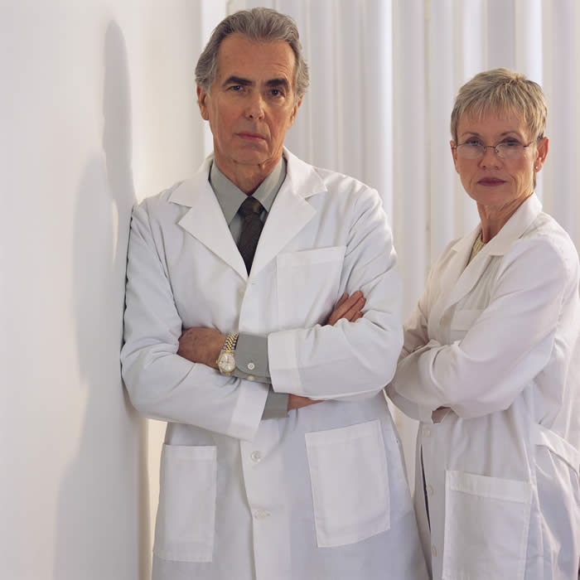
How does it work?
How will it work?
5 Annual Appraisals
Feedback from others about their work Information about the quality of their work
Evidence that they are keeping up to date
Responsible Officer
Recommendation
GMC

Slide 28
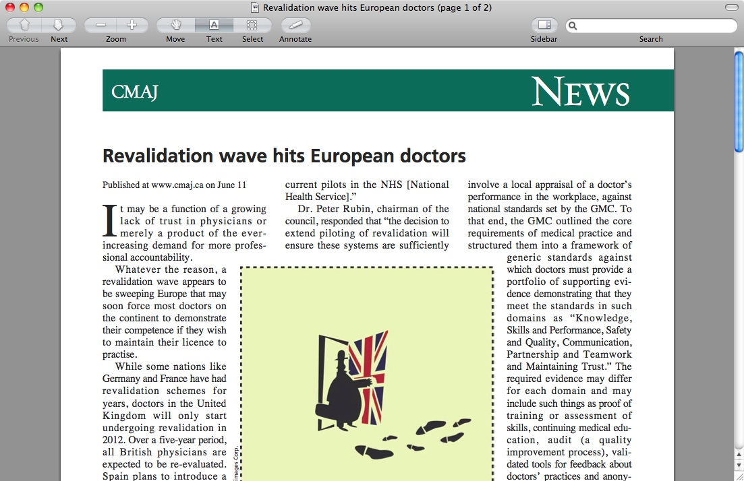
Revalidation in Europe

Slide 29
Revalidation in Europe
Portugal – no revalidation requirements
Belgium – voluntary CME, peer review and financial incentives
Germany – compulsory CME and financial penalties
Netherlands – compulsory CME and peer review
Spain – introducing initial voluntary scheme.
Poland – recertification but no sanctions

Slide 30
In summary….
Free movement of doctors and mutual recognition of qualifications across the EEA – language testing
Other IMGs have English language testing and take the PLAB test
All doctors working in the UK are required to revalidate
MLA introduced in 2022

Slide 31
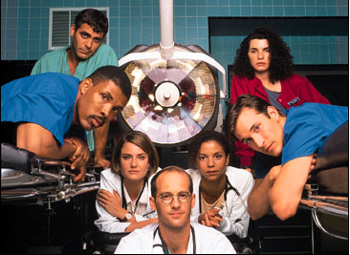
Thank you Any questions?

