Slide 1
Excellence in Medical Education
J. Palés
Facultad de Medicina Universidad de Barcelona

Slide 2
Some questions and thoughts from my own experience
To demystifie the word excellence

Slide 3
In recent years, greater value and emphasis has been placed on the word “excellence”
Our society understands that in the public institutions
research can only finance itself if it is excellent,
the engagement of (new) teaching staff will be based
on excellence,
there can only be teaching, care, research, professionals and research projects if they are excellent.
EXCELLENCE?
HIGH QUALITY?
TO DO THE BEST ACCORDING WITH OUR POSSIBILITIES?

Slide 4
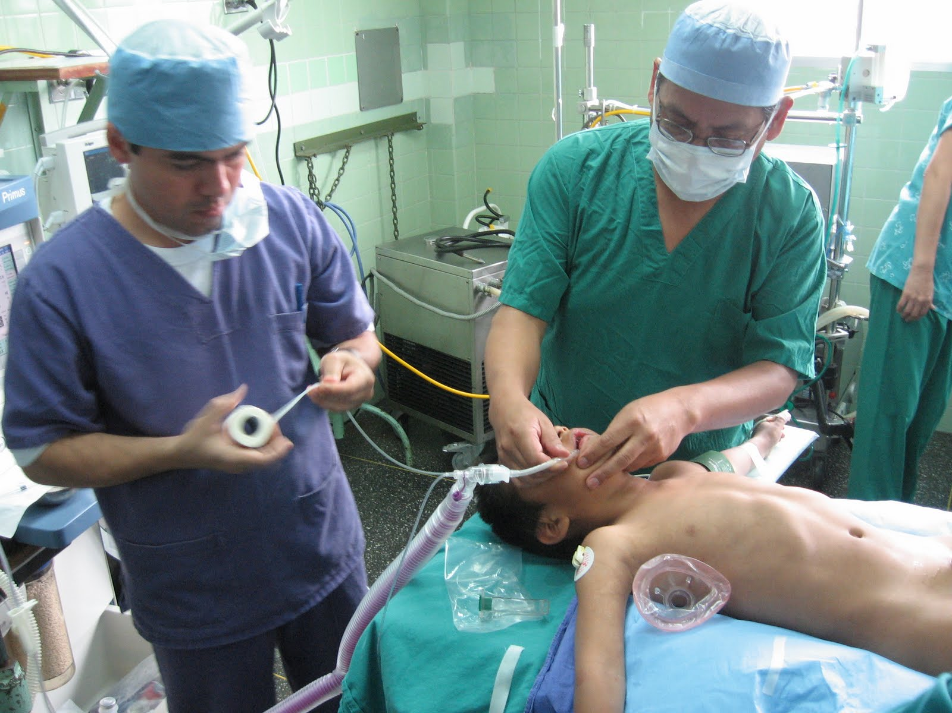
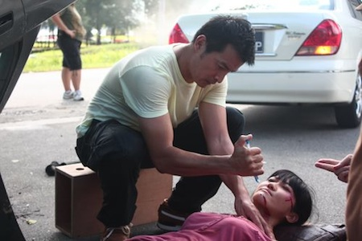
EXCELLENCE IS NOT AN ABSOLUTE VALUE EXCELLENCE IS CONTEXT-DEPENDENT
SOCIAL CONTEXT
ECONOMICAL CONTEXT
GEOGRAPHICAL CONTEXT
CIRCUMSTANCES
ETC…

Slide 5
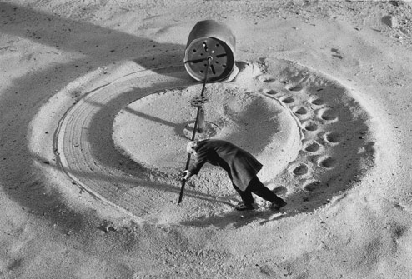
Universal excellence is proposed as a standard of improvement.
Often excellence lobbies use the meaning of words to their own convenience in order to sell their product to society.
Only excellent groups are financed. Other groups (good groups, but not “excellent” are neglected and they cannot improve easily (in biomedical research and teaching too), they cannot obtain funds, they cannot publish easily
If you are not in the elite, you are not considered
VICIOUS CIRCLE

Slide 6
Some questions about excellence
Can anyone in their right mind really be against excellence?
Can anyone defend the idea that research or
human resources, teaching staff or researchers do not need to be excellent?
NO

Slide 7
Some questions
Can anybody defend the notion that both generating and transmitting knowledge–the two prime responsibilities of universities–do not have to pursue excellence?
NO
Do we want an excellent university?
YES

Slide 8
But

Slide 9
Where is the fallacy?

Slide 10
The fallacy lies in the question itself. It is a question that is neither well-posed nor well-meaning.
The question as to whether we want an ‘excellent’ university is not a question –it is a something that is obvious.
A university, if it is a university, has to be or has to tend towards excellence. It should be inherent.

Slide 11
Correctly formulated, the questions would be others, such as:
Is our university excellent, or does it strive to be? What must a university do to be excellent?
Do we do the right things, from within and from outside to have and maintain an excellent university?

Slide 12
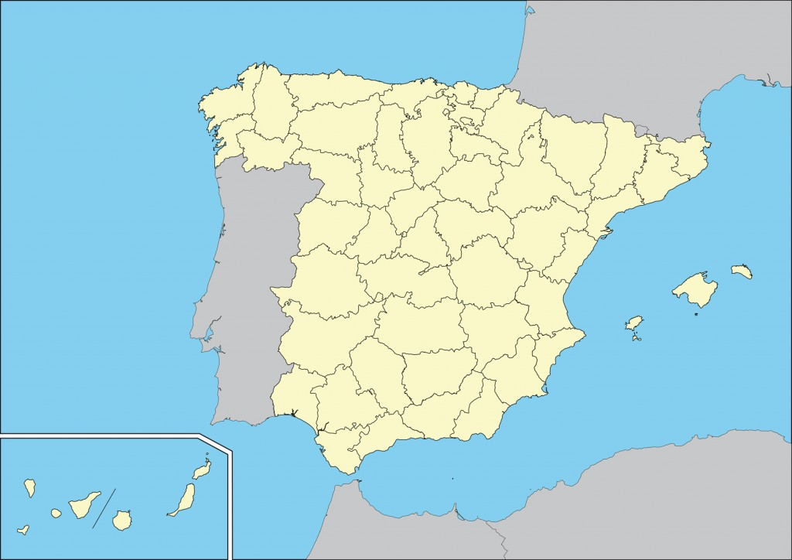
In relation to our socioeconomic surroundings we have in general an acceptable quality university, with good human resources;
the efforts made by the universities and the members of the university community to accomplish their mission of generating and transmitting knowledge go far beyond the level of the resources they have available to them.
Despite all these positive points our university is not excellent (strictu sensu)
Between where we stand and where we want to be there is still quite a gap to cover. And at this point another relevant question pops up:
How do we cross the gap between the university as it stands today and the one we want for tomorrow?
WHAT HAPPENS IN SPAIN?

Slide 13
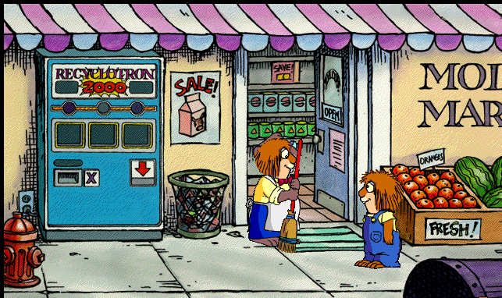
DO YOU SELL EXCELLENCE?
HOW MUCH?
Excellence cannot be bought overnight.
Excellence is not a finished, standardised product that is on the market.

Slide 14
Rather, it is the result of a collective ongoing struggle that is based on sacrifice, imagination and shared talent.
How to get excellence?

Slide 15
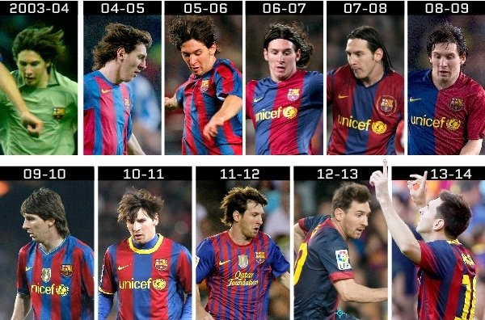
We may consider drastic solutions like :
Dismissing all the human resources available and taking on only the best players to build a team of galactic superstars.
The excellence is a long journey

Slide 16
We could let the existing universities die with its people inside them so that new structures can be built with only the best teachers and researchers.
But these solutions are not, and never have been, realistic or possible
To generate centres of excellence that are a far cry from the university

Slide 17
More questions?
In medical schools is it possible for any individual at the same time to be EXCELLENT IN:
TEACHING & TEACHING RECOGNITION

Slide 18
Manager
Teaching
Research
Clinic

Slide 19
There is always a weak link in the chain
TEACHING

Slide 20
In general, in Spanish Medical Schools, biomedical research has a good level that has increased in the last years due essentially to
Increase of Funding
Assessment of research quality that determines more funding
Promotion in the academic career is based principally on biomedical research results, not in teaching quality or research in education.

Slide 21
Little recognition of teaching tasks (more biomedical research production, less teaching tasks are assigned)
Poor consideration of teaching quality in academic promotion
Why to waste time in changing in teaching?
Low interest in research in medical education
No specific training in medical education research
Research in education is based on amateurism and voluntarism
No funds for research in Medical Education

Slide 22
How to drive during the long and not easy journey to the excellence ?

Slide 23
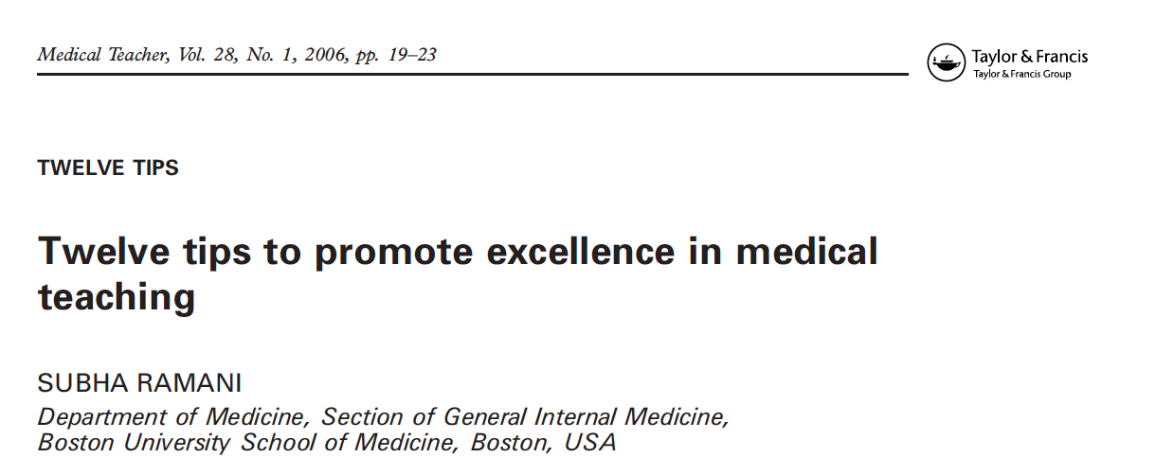

Slide 24
TIPS TO PROMOTE EXCELENCE IN ME | SPAIN
Establish explicit learning and teaching outcomes to help teachers | Poor
Make the link between evidence-based medical practice and evidence-based medical education | Poor
Faculty development is an important instrument to create a positive learning environment for teachers | Some activities Few attendants

Slide 25
TIPS TO PROMOTE EXCELENCE IN ME | SPAIN
Evaluation of teaching. Tell the teachers how they taught | Formally yes Low impact
Evaluate impact of teaching. Find out how the teaching affected learners | None
Mentoring | None
Promote an institutional culture that values teaching highly equivalent to that of research | Yes in formal declarations. No real actions

Slide 26
TIPS TO PROMOTE EXCELENCE IN ME | SPAIN
Institutional funding for educational research | No at national level Few funds at the university level
Rewarding excellence in teaching | No
Introduce all medical educators to the scholarship of teaching | No
Participate in the BEME collaboration | No

Slide 27
self-complacency
syndrome

Slide 28
Because our educational institutions are solidly anchored in a curriculum and teaching of the XIXth century model and the attempts to modernize them that have launched near the end of the XXth century and early XXI have not been successful, how must proceed?
The problem is serious and has multiple causalities. The regulatory framework is one of them and to change it, is a serious political problem, but it's not the only problem.
There is another almost as severe as the previous one. It is called IGNORANCE. While we are not familiar with what happened and is happening in the world, we can not perceive the possibility of improving, doing things differently, depending on what they have experienced other improvements to get recognized.
A. Oriol

Slide 29
But a long journey that never ends

Slide 30
Gracias por su atención
Thank you for your attention
jpales@ub.edu
Notes:
30

