Slide 1
Transitions in medical education: purpose, impact and legacy
Trudie E. Roberts
Director, Leeds Institute of Medical Education and AMEE President

Slide 2
Outline
The past
The present
Impact of changes in medicine and Healthcare delivery
The doctor of the future
The way forward

Slide 3
The past – ‘a golden age’
Patients were passive and grateful
Regulation of doctors was controlled by doctors themselves
Public accountability was negligible
Social prestige was high

Slide 4
The past ……
Training was long and doctors learnt from seeing many patients
Patients stayed in one place and doctors learnt from the evolution of a patient’s condition
Patients had limited understanding and were compliant
Most learning was in formal face to face teaching
Changes in medical knowledge took time to be adopted
Treatment was largely based on traditional practice

Slide 5
The PHOG approach to teaching
Prejudice
Hunches
Opinion
Guesses

Slide 6
Moving to the Present
In the past medicine was simple, safe and largely ineffective.
Now it is complex, effective and highly dangerous
Cyril Chantler 2003

Slide 7
The Changing Healthcare System
Population changes
Changing focus of illness
Increase in medical knowledge
New diseases
The changing learning environment
Changing focus of patient treatment
Change in doctors working hours
The change in public expectations

Slide 8
The Changing Composition of Societies
Population movement
Globalisation and migration
Development of cultural diversity

Slide 9
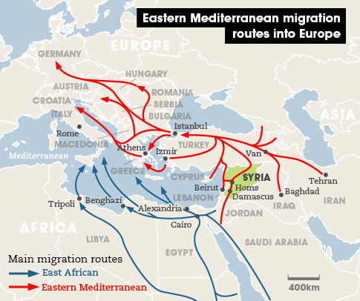

Slide 10
Changing population demographics

Slide 11
Changing disease profile
Changing demographics
230 per 1000 people over 65 in the UK
850,000 suffering from dementia,
>80% with multiple morbidities

Slide 12
Knowledge doubling times
1750 - 1900
150 years
1900 - 1950
50 years
1960 - 1965
5 years
2020
73 days
Ronald Harden 2005

Slide 13
New diseases
SARS
MERS
Ebola
Zika

Slide 14
The Change in Public Expectations
Consumer society
Empowerment
Choice
Informed public
Increased access to information

Slide 15
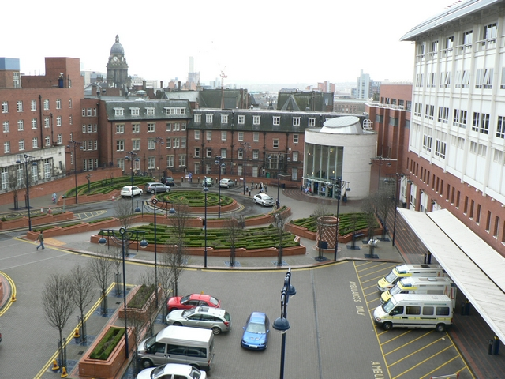
The changing focus of patient treatment
From hospital to community

Slide 16
How doctors learn
Doctors learn from interactions with patients

Slide 17
Hospital beds per 1,000 people

Slide 18
EU Average in-patient length of stay

Slide 19
AMI length of stay

Slide 20
Changes in doctors working hours

Slide 21
The challenge then is….
Maximise learning opportunities to cope with the demands of modern medical practice

Slide 22
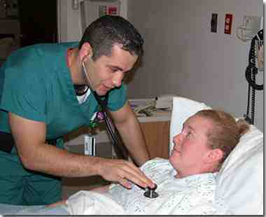
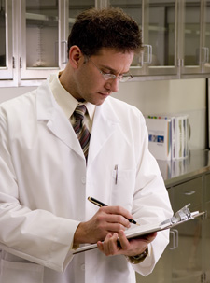
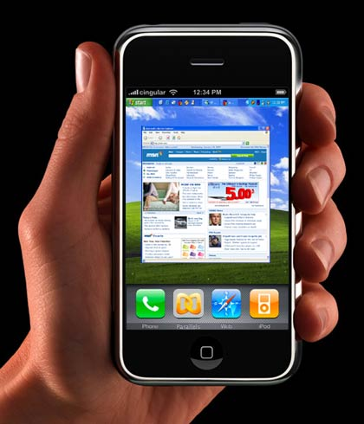
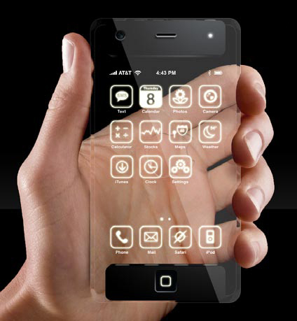
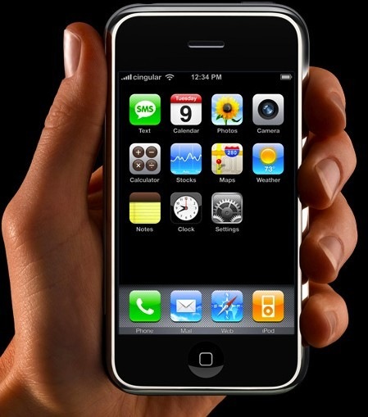
Technology supported ‘patient Journey’ learning
Doctor sees patient
Student confirms or refines original diagnosis
Student formulates diagnosis
Student has remote access to patient progress

Slide 23
Conclusions
Medical curricula need to reflect changes and need regular review
Students need to be trained where patients are treated
Technology can support learning
Students need to be prepared to work with more informed patients

Slide 24
THE TECHNOLOGY REVOLUTION IN HEALTHCARE
Alzheimer’s: 5 million Americans. Wireless sensors can track the vital signs of patients as well as their location, activity, and balance.
Asthma: 20 million Americans. Wireless can track the respiratory rate and peak flow so patients can use inhalers before an attack occurs.
Breast Cancer: 3 million Americans. Women can use a wireless ultrasound device at home and send the scan to the doctor–won’t have to go in for a mammogram.
Chronic Obstructive Pulmonary Disorder (COPD): 10 million Americans. Wireless can monitor FEV1, air quality and oximetry.
Depression: 19 million Americans. Wireless can monitor medication compliance, activity and communication.
Diabetes: 21 million Americans. Wireless can monitor blood glucose and hemoglobin.
Heart Failure: 5 million Americans. Wireless can monitor cardiac pressures, fluids, weight and blood pressure.
Hypertension: 74 million Americans. Wireless can continuously monitor blood pressure and track medication compliance.
Obesity: 80 million Americans. Wireless scales can track weight and wireless sensors can track calories in/out and activity levels.

Slide 25
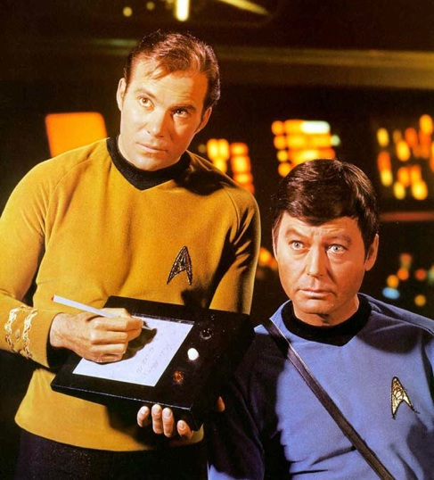
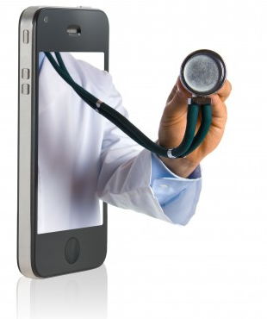
The Doctor of the future

Slide 26
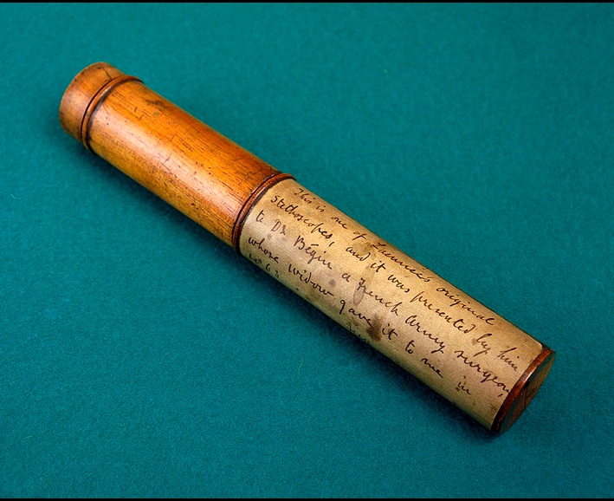
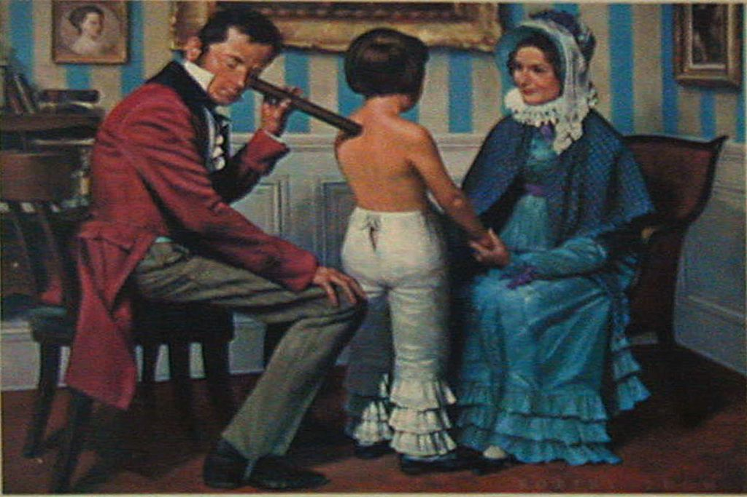
Cardiovascular examination

Slide 27
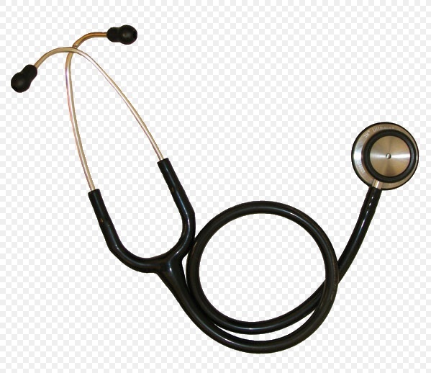

Slide 28
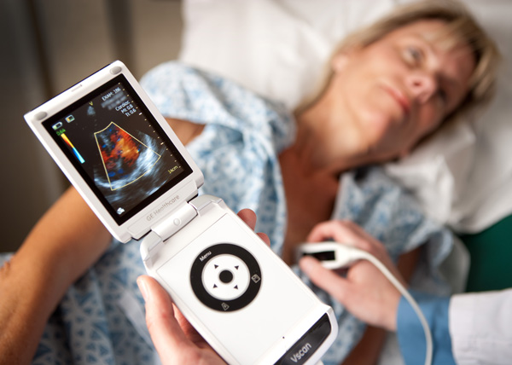

Slide 29
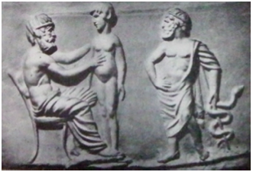
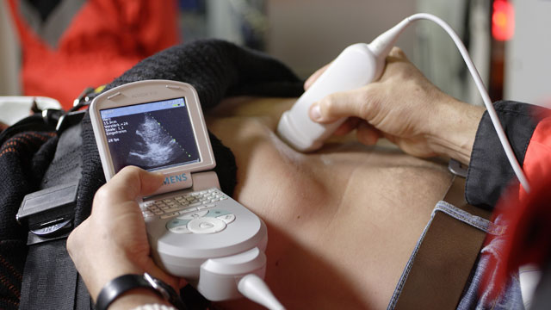
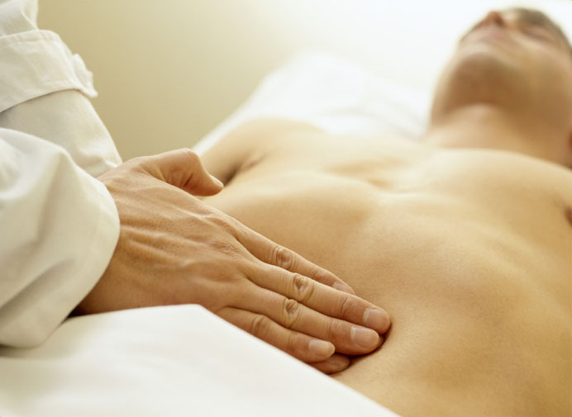
Abdominal examination

Slide 30
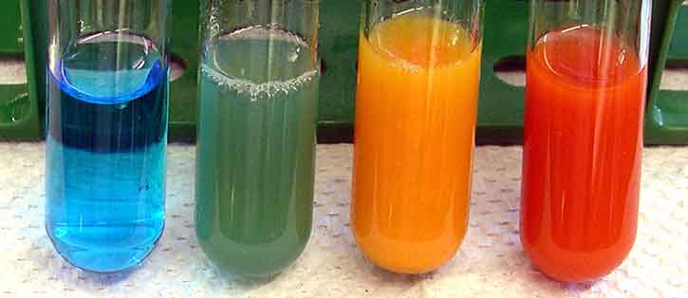
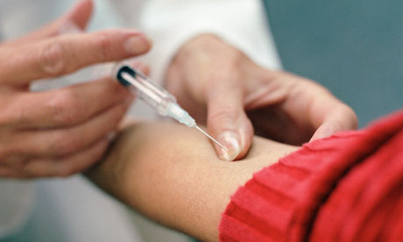
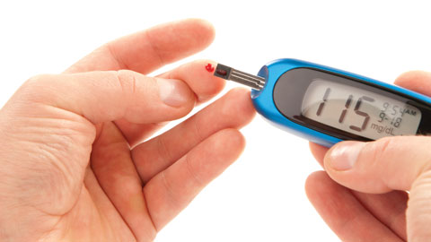
Diabetes

Slide 31
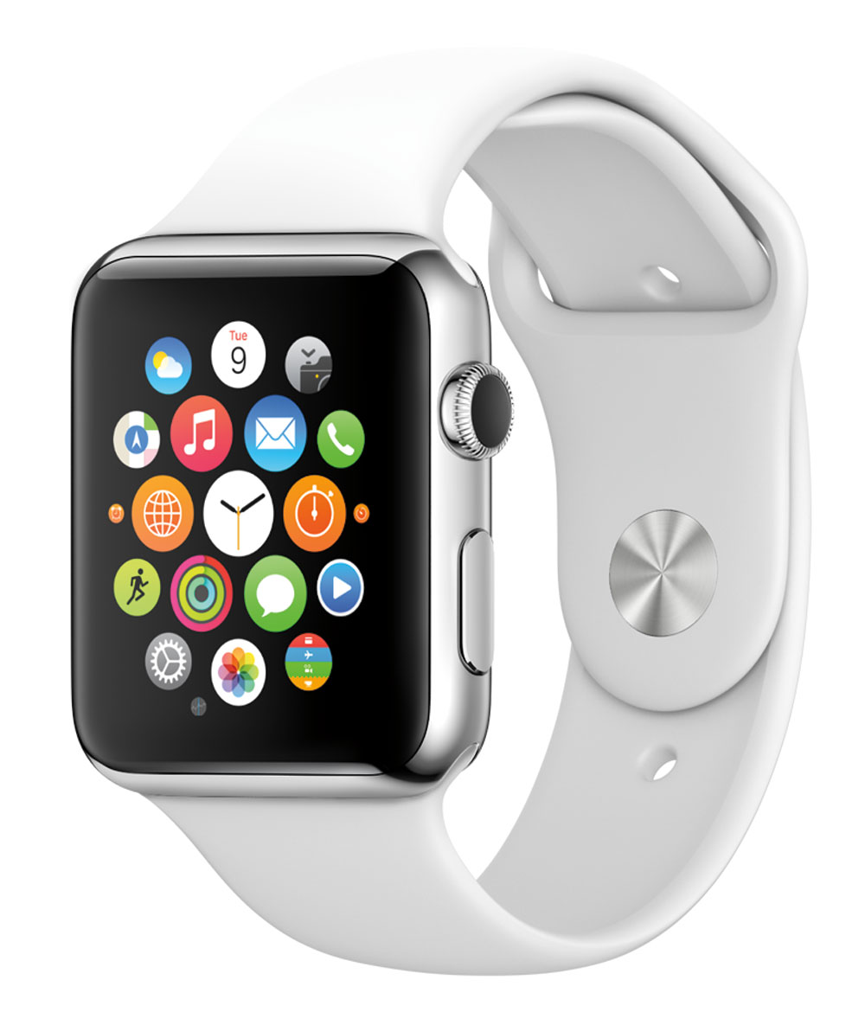
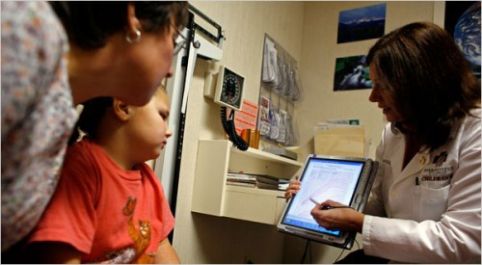
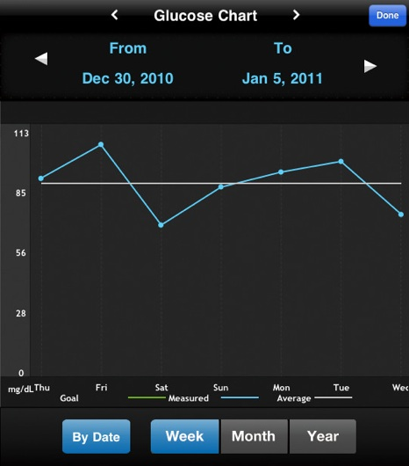
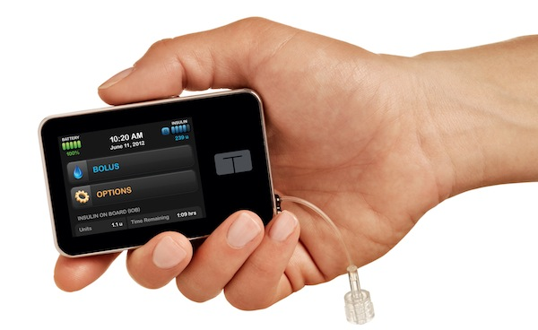

Slide 32
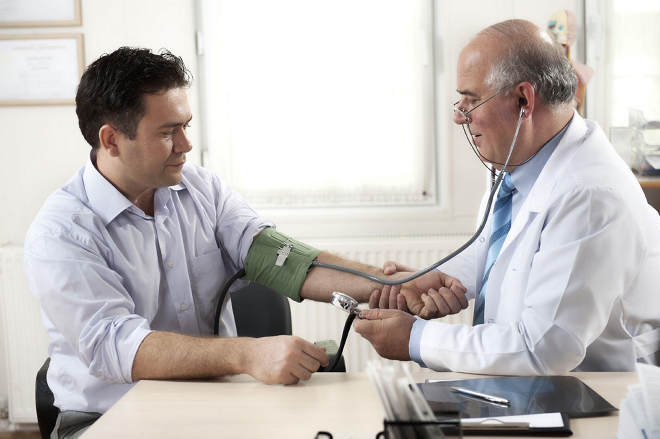
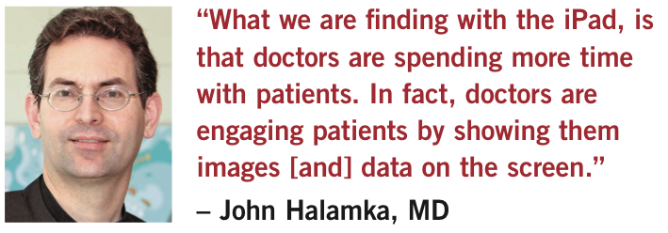
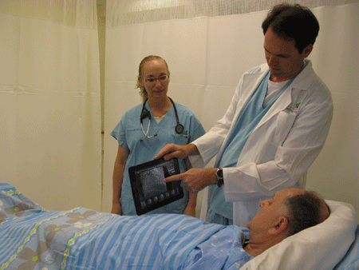
Is this the death of communication skills?

Slide 33
Skills of the future
Motivation
Negotiation

Slide 34
E-patients
I'm an e-patient: equipped, enabled, empowered, engaged. I'm no clinician, but I do everything in my power to help them, to play an active role in my own care, and even in the design of care.
Dave deBronkart

Slide 35
The future doctor?

Slide 36
conclusion
Medical education needs to recognise how future health care will be delivered
and
ensure our graduates are equipped to work in and lead such a system

Slide 37
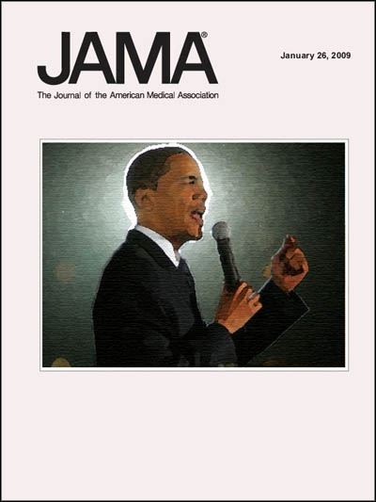
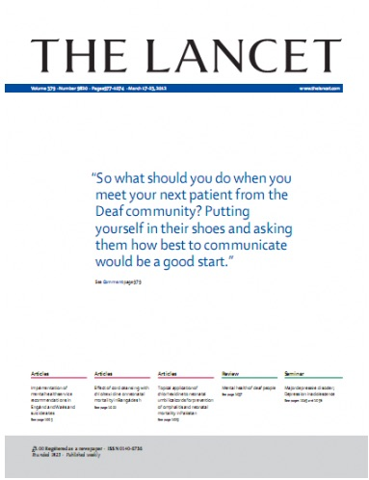
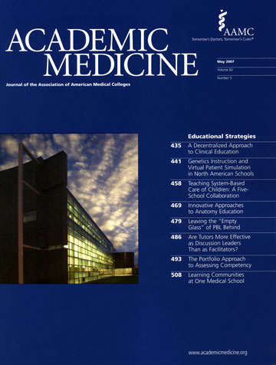
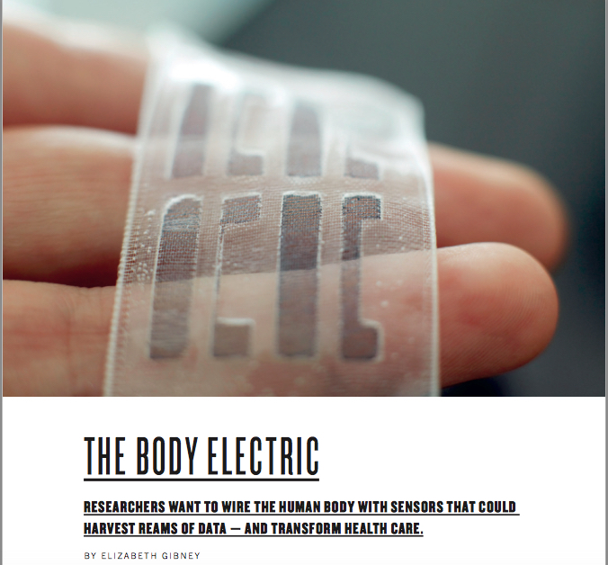
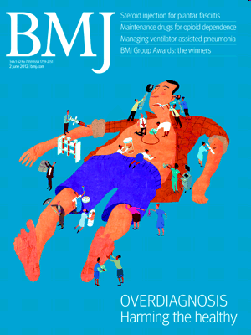
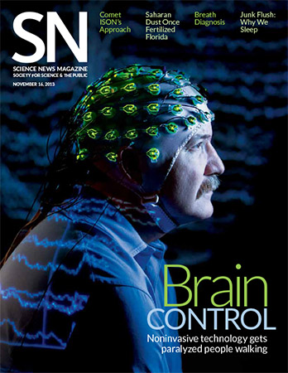
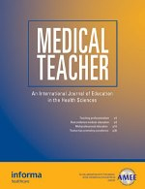
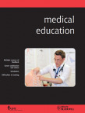
What are the implications for medical educationalists?

Slide 38
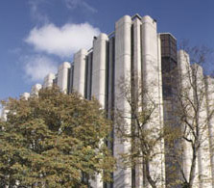
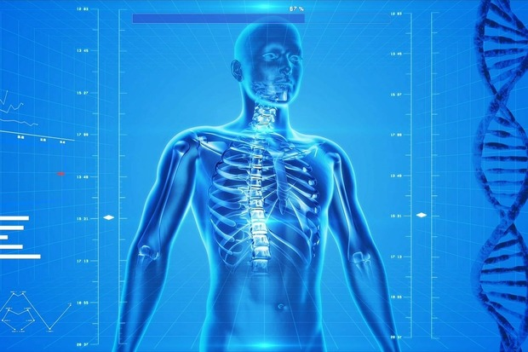
Leeds Medical school
Leeds - Training Students Today to Lead Healthcare Tomorrow

Slide 39
Technology supported ‘near patient’ learning
Student sees patient
Student designs a treatment plan
Student formulates diagnosis
Student consults literature/guidelines

Slide 40
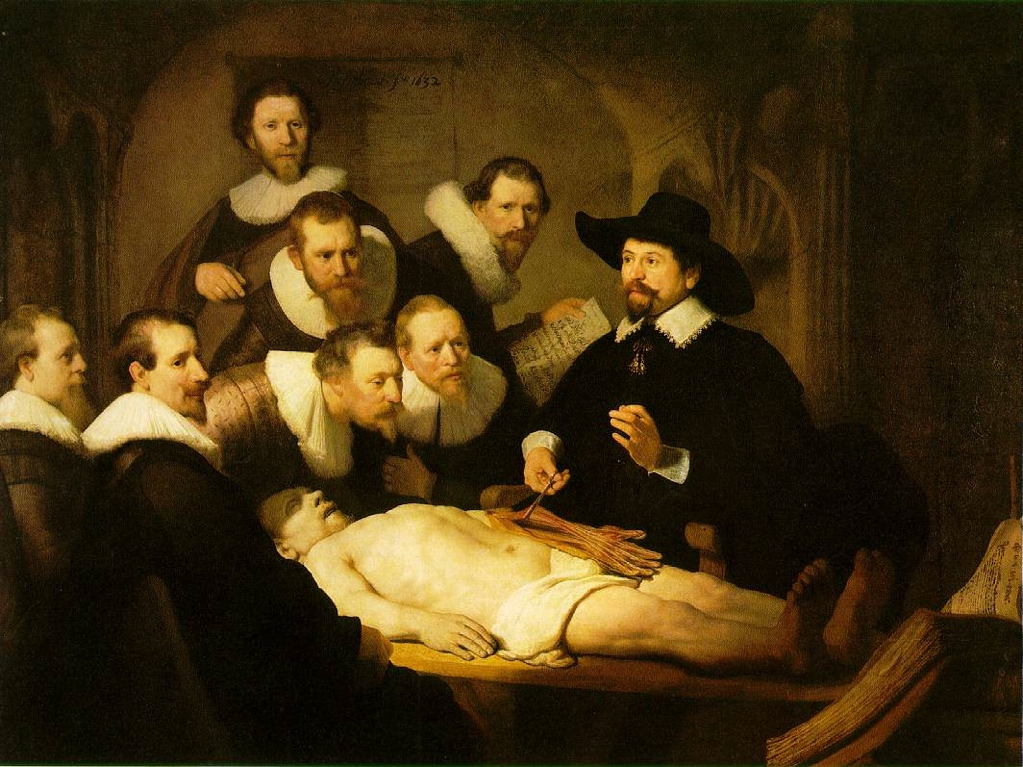
Anatomy teaching

Slide 41
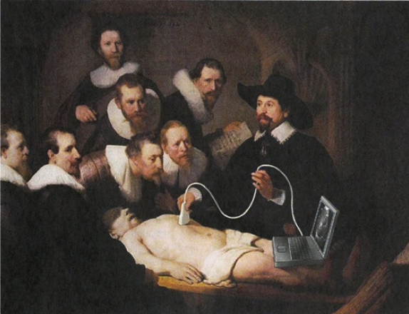

Slide 42
‘Wearables’

Slide 43
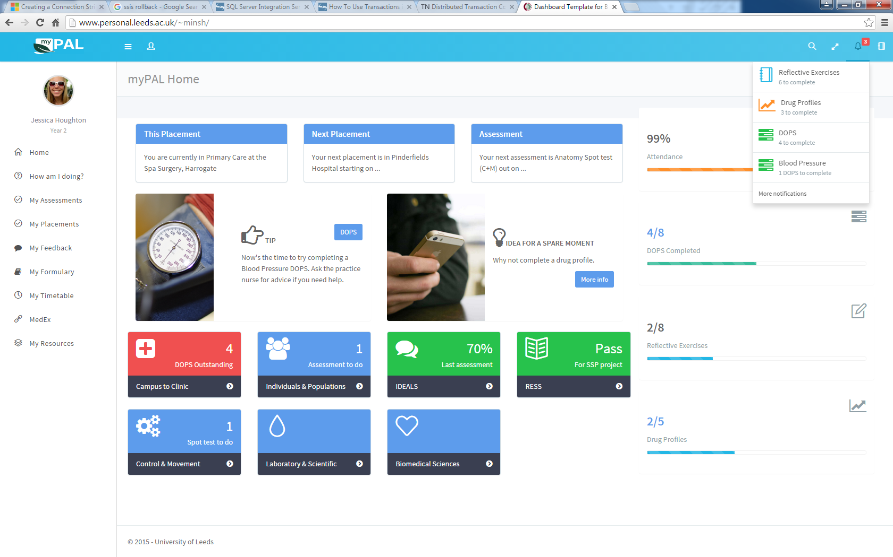
Personal Adaptive Learning
http://www.personal.leeds.ac.uk/~minsh

Slide 44
Final conclusion
The future has already started and we need to embrace it

Slide 45
Go boldly

