Slide 1
New perspectives in CME
J. Palés
Facultad de Medicina Universidad de Barcelona

Slide 2
Individual Continuous Professional Development (CPDi)
and
Continuous Medical Education (CME)

Slide 3
CPDi
Process by which a professional maintains and improves his/her degree of competence

Slide 4
It is part of the ideology of professionalism
CPD
To offer at all time a professional practice in line with health- scientific currents and to the health system in which he/she practices Longest step of the educational continuum and really determinant of good medical practice
It has its roots in the ethical and professional commitment to maintain competence during the active life

Slide 5
CPDi
Must stimulate the improvement of all professional activities
It implies an active and dynamic progression, maintained throughout professional life
Searching of excellence including knowledge, skills and attitudes
Must be adapted to the needs of the health system and employers organization
Step beyond the traditional concept of CME which has a more limited scope and less oriented to the quality of health system and professional organizations

Slide 6
Goals of CPDi
To maintain and improve the individual professional competency
To guarantee the quality of the professional performance
To recognize the individual effort in maintaining of competency
To recognize the capacity to adapt to changes and needs

Slide 7
My update is permanent, voluntary and enthusiastic
To maintain my competence and guarantee the quality of my performance
CPD
this motivates me to continue updating
and therefore my effort to maintain my competence and my ability to adapt to changes are recognized

Slide 8
Components of CPD
 | Basic Components of CPD
1 | Continuous Medical Education (CME)
2 | Clinical Activities
3 | Research, Teaching and Management activities
4 | Other activities of improvement
Ethic values and Professionalism

Slide 9
Continuous Medical Education (CME)
Set of professional training activities done throughout his/her life, once obtained a basic or specialized degree that allows his/her to practice

Slide 10
The goal of CME is:
To mantain and improve the individual professional competency. It is a duty of any professional

Slide 11
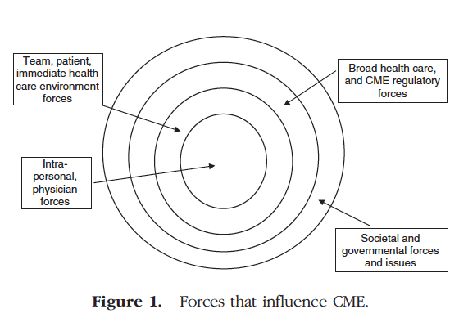
FORCES INFLUENCING CME

Slide 12
Planification of CME
To detect and evaluate the learner needs
To establish the educative objectives
To establish the adequate format of CME activities
Shift from participation to intervention
To assess of CME
To accredit the CME

Slide 13
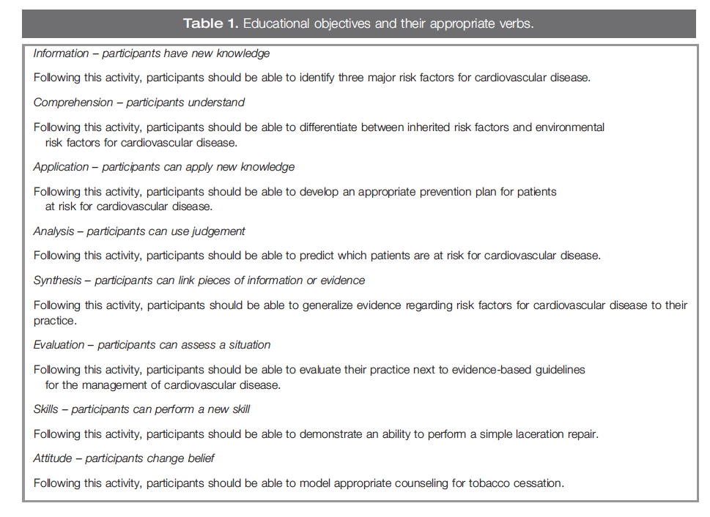
EDUCATIVE GOALS OF CME

Slide 14
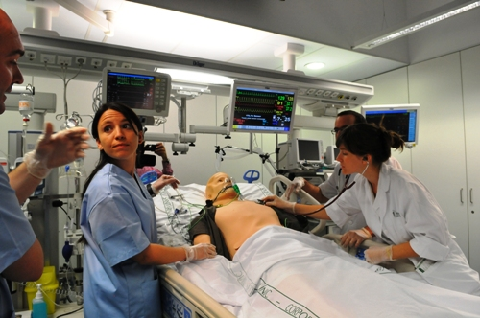
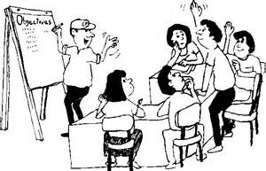
- PRESENTATION
+ INTERVENTION

Slide 15
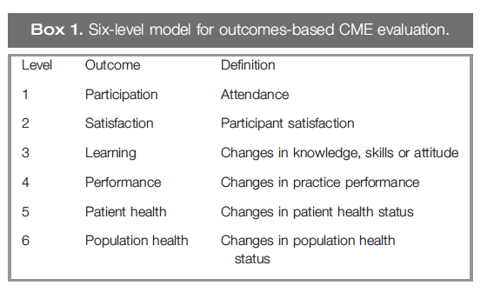
Assessment of CME

Slide 16
CRISIS model (Harden)
Convenience: education available at the right place, at the right time and at the right pace”
Relevance: addressed to cover the competencies lacking
Individualization: take in account the characteristics of the learner
Self-Assessment: to identify needs and to check if learning outcomes have been achieved
Interesting
Systematic and speculative: controversial areas. Systematic programmes

Slide 17
CME Activities Accreditation
CME accreditation represents the nuclear element of any accreditation system
To establish quality differential criteria among different teaching activities to improve the formative offer and facilitate the selection by the physician

Slide 18
SEAFORMEC is a Spanish system of accreditation of activities of CME
SEAFORMEC accredits different activities to optimize the benefits of the teaching activities addressed to Spanish physicians

Slide 19
CRITERIA | CONSIDERED ASPECTS
JUSTIFICATION | HOW HAV BEEN DETECTED THE LEARNING NEEDS?
LEARNING OUTCOMES | GENERAL SPECIFIC
ORGANIZATION | PROGRAMME HUMAN RESOURCES MATERIAL RESOURCES
TEACHING METODOLOGIES | FACE TO FACE ON-LINE GROUPS
ASSESSMENT | NON SPECIFIED SATISFACTION SURVEY ASSESSMENT ALONG THE ACTIVITY FINAL ASSESSMENT WITH QUALIFICATION SKILLS ASSESSMENT WITH EVALUATION OF THE IMPACT
Qualitative evaluation by peer review of different elements of the activity. We obtain a quantitative factor that allows calculate the number of credits

Slide 20
Some data of CME in Spain

Slide 23
CONCLUSIONS
Based on the real perceived needs
To use adults learning strategies
Available next workplace
The content of CME must no be influenced by commercials organizations that finance it
CME: Update of knowledge and maintaining of the professional competency of physicians
Shift from the improvement of knowledge to improvement of performance of physicians
Recognition of CME activities across borders

Slide 24
Thank you for your attention
Gracias por su atención
jpales@ub.edu
Notes:
24

