Slide 1

How can MOOC’s be used for Science Teaching?
IAMSE Symposium at COPAEM/CIEM 2016
Peter GM de Jong
Center for Innovation in Medical Education
Leiden University Medical Center, Netherlands

Slide 2
Massive Open Online Courses
Massive Open Online Courses (MOOCs)
Open Educational Resources movement
2008: first MOOC by George Siemens and Stephen Downes (2200 participants)
New concept:
Online only, no face to face activities, distance learning
Structured program covering several weeks
Free registration (open)
> 1000 participants (massive)
Disruptive technology: As of June 2016 Coursera had reached more than 18 million students! “The student as a self-motivated learner”

Slide 3


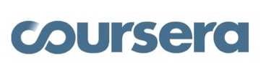




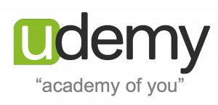
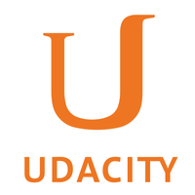
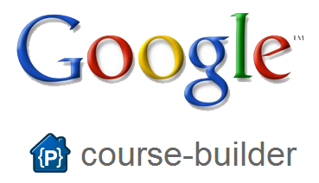
Massive Open Online Course providers

Slide 4
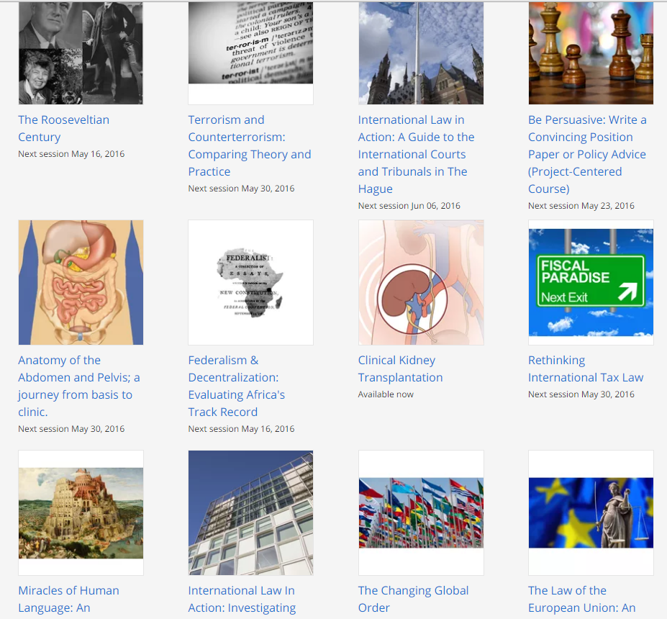
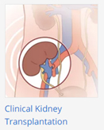
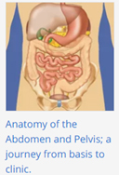
Massive Open Online Course (Leiden University)

Slide 5
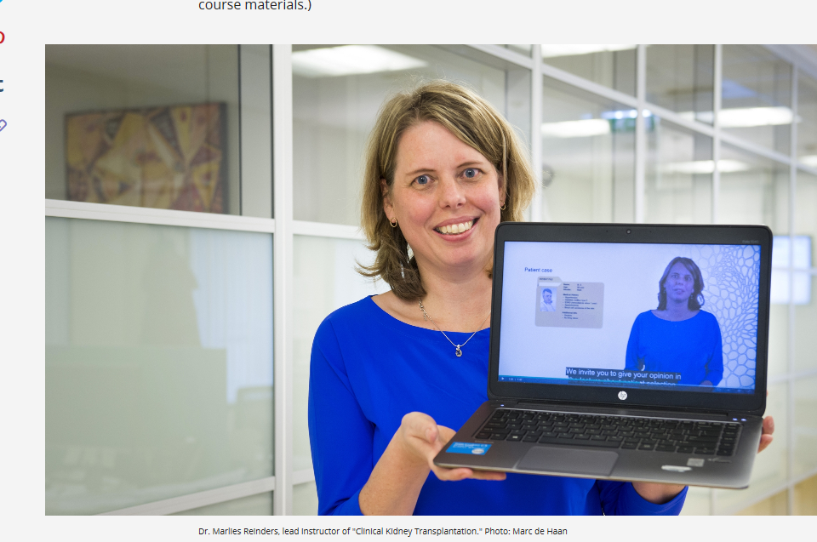
Clinical Kidney Transplantation
Dr Marlies Reinders & team
Leiden University Medical Center

Slide 6
Clinical Kidney Transplantation
Learning goals: Understand basic and clinical transplant medicine
Target group:
Students: advanced undergraduate or graduate level
Medical professionals in preclinical or clinical transplant field
Anyone interested in kidney transplantation
Scheduled and on demand

Slide 7
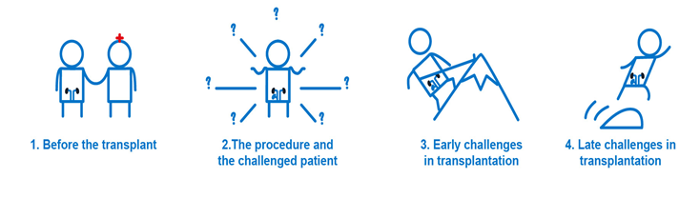
Clinical Kidney Transplantation
4 modules/weeks

Slide 8
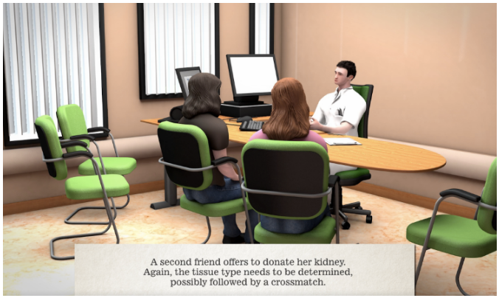
Clinical Kidney Transplantation
Content of a MOOC:
Video lectures (5 min)
Animations
Transplantation procedure/ complications
Games
Patient encounters
Reading materials
Weekly/ final quiz
Moderated online assignments (Etivities)
Assessment

Slide 9
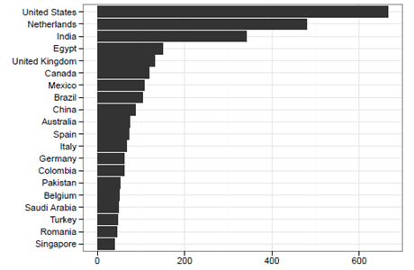
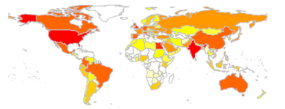
Clinical Kidney Transplantation

Slide 10
Clinical Kidney Transplantation
Personal learning paths
Professionals decide to do other elements than undergraduate students
      Watching the lectures?
      Opening the readings?
      Watching optional (advanced) interviews, lectures and readings?
      Making quizzes: including number of attempts, scores?
      Doing the games?
      Making the online assignments?

Slide 11
Massive Open Online Courses
Many courses available in the field of medicine
Coursera: as of June 2016 78 MOOCs in Medicine and Healthcare
Medical Neuroscience (Duke)
Introduction to the Biology of Cancer (John Hopkins)
Advanced Neurobiology (Beijing)
Bacteria and Chronic Infections (Copenhagen)
…
Many more on other platforms…

Slide 12
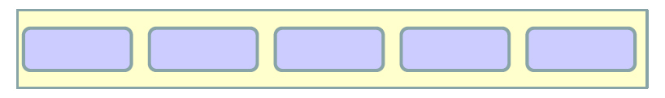
Use of MOOC in education
1 Import specific elements from a MOOC in your teaching environment
Animations
Readings
Cases
-
MOOC

Slide 13
Use of MOOC in education
2 Refer the students to the MOOC to fulfill specific modules
MOOC as a book, Replacement of lectures, Discussion platforms
Discuss the content in small group setting
Advantage:
Students might become interested by other materials
Participate in fora with many other (international) participants
MOOC

Slide 14
Use of MOOC in education
3 Include a MOOC in other programs as obligatory part
Honors program
-
MOOC A
MOOC B

Slide 15
Conclusion
There are many MOOCs in Medicine available
The use of MOOCs is free!
Can be used in different ways in your own curriculum
In addition to or as replacement of regular teaching

Slide 16

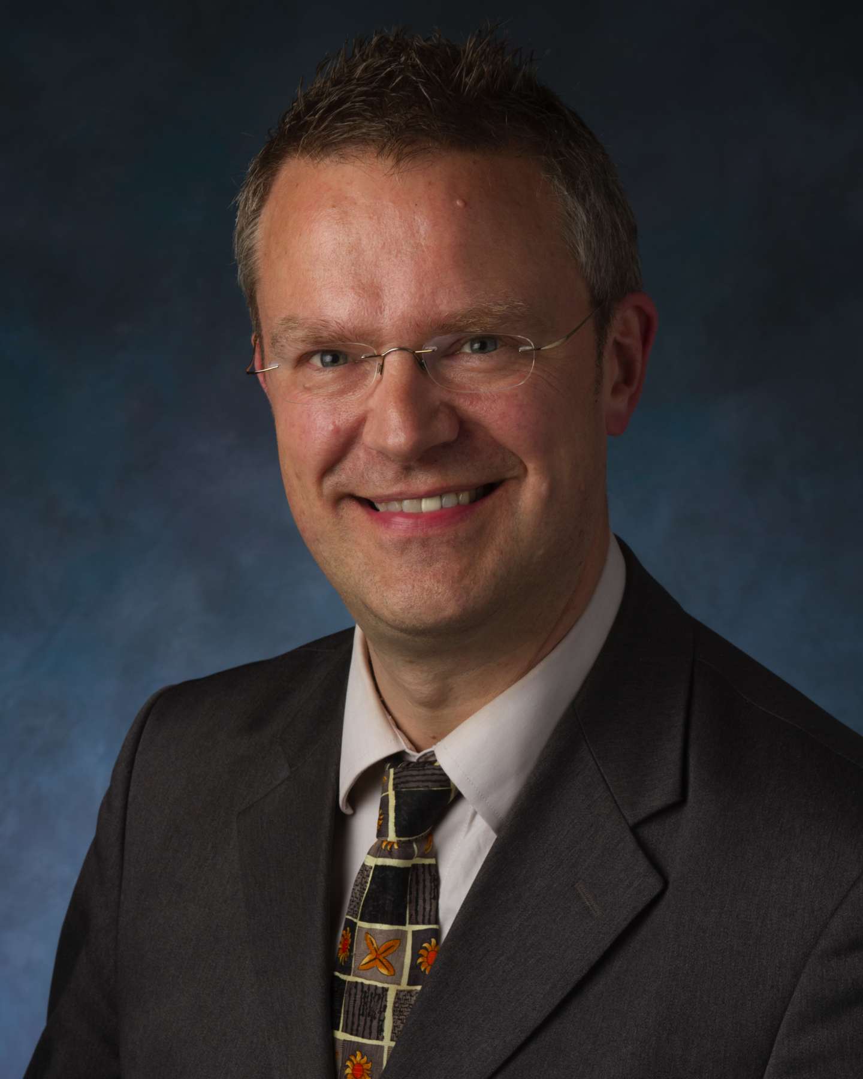
Conclusion
Peter GM de Jong
p.g.m.de_jong@lumc.nl

