Slide 1
Europe: evaluation, accreditation, coordination
David Gordon
WFME

Slide 2
What is Europe?
European Union Europe?
“Geographical” Europe? – to the Ural Mountains
Council of Europe Europe?
WHO Europe?

Slide 3
What is Europe?
European Union Europe?
“Geographical” Europe? – to the Ural Mountains
Council of Europe Europe?
WHO Europe?

Slide 4
What is Europe?
European Union Europe?
“Geographical” Europe? – to the Ural Mountains
Council of Europe Europe?
WHO Europe?

Slide 5
What is Europe?
European Union Europe?
“Geographical” Europe? – to the Ural Mountains
Council of Europe Europe?
WHO Europe?

Slide 6
What is Europe?
European Union Europe?
“Geographical” Europe? – to the Ural Mountains
Council of Europe Europe?
WHO Europe?

Slide 7
Relevant EU directives
Directive 2005/36/EC
Directive 2013/55/EC

Slide 8
2013/55/EC
“temporary mobility – this scheme allows professionals to work in another EU country on the basis of a declaration made in advance;
establishment in another EU country – the directive lays down rules for professionals who want to establish themselves as:
  an employed or self-employed person;
  on a permanent basis;
  in a country where they didn’t obtain their professional qualification;
systems of recognition of qualifications – there are three systems of recognition:
  automatic recognition – for professions with harmonised minimum training conditions (i.e. nurses, midwifes, doctors (general practitioners and specialists), dental practitioners, pharmacists, architects and veterinary surgeons);
  general system – for other regulated professions such as teachers, translators and real estate agents;
  recognition on the basis of professional experience - for certain professional activities such as carpenters, upholsterers, beauticians etc.;
knowledge of languages and professional academic titles.”

Slide 9
“… professions with harmonised minimum training conditions (i.e. nurses, midwifes, doctors (general practitioners and specialists), dental practitioners, pharmacists, architects and veterinary surgeons)”

Slide 10
“Basic medical training shall comprise a total of at least five years of study, which may in addition be expressed with the equivalent ECTS credits, and shall consist of at least 5 500 hours of theoretical and practical training provided by, or under the supervision of, a university”
… followed by very sensible requirements about basic science, pathology, clinical sciences, behavioural science, clinial experience and so on

Slide 11
Note: different style and content between requirements for basic medical education, and requirements for specialist training
Despite the requirements of 2013/55/EC, EU Europe is more diverse than most other parts of the world in attitudes and practices in medical education …

Slide 12
The Bologna Process
At one time a major issue – now largely passed

Slide 13
Bologna Action Lines – almost all good for Medicine
Adoption of a system of easily readable and comparable degrees
Adoption of a system essentially based on two cycles
Establishment of a system of credits
Promotion of mobility
Promotion of European co-operation in quality assurance
Promotion of the European dimension in higher education
Focus on lifelong learning
Inclusion of higher education institutions and students
Promotion of the attractiveness of the European Higher Education Area
Doctoral studies and the synergy between the European Higher Education Area and the European Research Area

Slide 14
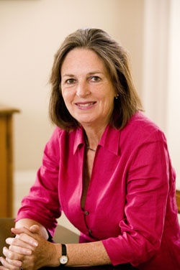
History – what was the aim at the start?
Sorbonne 1998 and Bologna 1999 – ministers recognising the need for reform in higher education (why?)
The two cycle model was intended as a tool to get educated people into the workforce after 3 years and as a tool for better European integration, not necessarily as an objective in its own right.
“...first cycle studies, lasting a minimum of three years. The degree awarded after the first cycle shall also be relevant to the European labour market as an appropriate level of qualification....”
Bologna signatories never considered the position of medicine (and the related subjects) and there is no evidence of any intention to split the medical course into two cycles

Slide 15
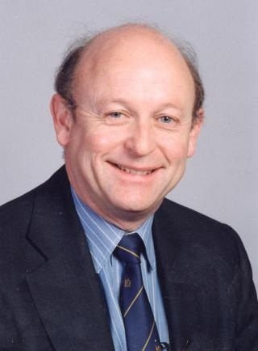
"[T]he Education Committee [of the GMC] has statutory powers over the content and outcomes of undergraduate medical education in the UK. The Committee can see no merit in applying the Bologna process to medical education - a view which is shared by all four Government Administrations in the UK - and we have no intention of changing the current, internationally respected arrangements. Introducing the Bologna proposals would put medical education here back a generation.
... [T]he Regulator, the Medical Schools and the Administrations of the four countries of the UK all wish to see the educational excellence, forward thinking and patient focus of medical education here continue."
Peter Rubin, (then) Chair, Education Committee

Slide 16
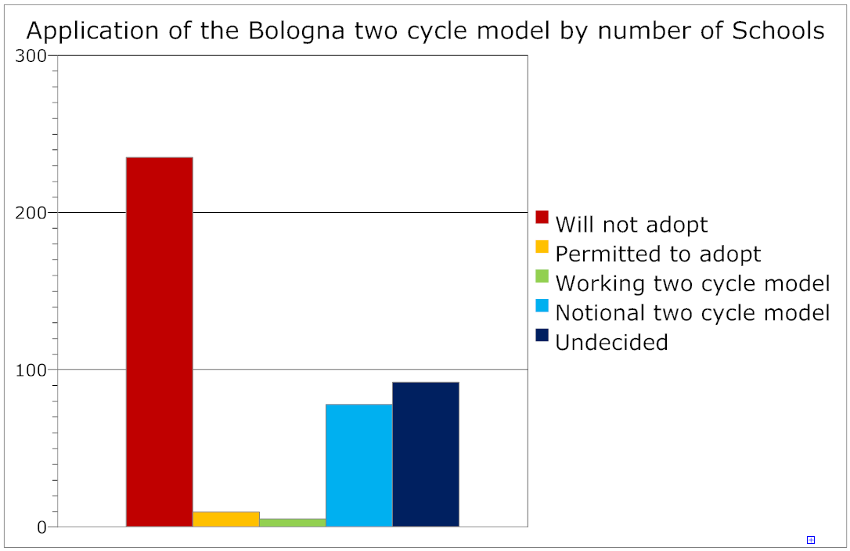
How widespread will a “real” two-cycle model be?

Slide 17
Why the subject is not resolved? What are the positive aspects of two cycles?
Time to re-think the structure of the course
An opportunity to revise outdated curricula
Mobility?
  and student support for all of these

Slide 18
In conclusion
When you say “Europe”, define what you mean
Within EU Europe, there are clear and helpful requirements for basic medical education (often used beyond the EU)
Requirements for postgraduate education are less clear and coordinated
Europe remains very diverse
The Bologna process and medical education was an “interesting” diversion

