Slide 1

Medical Education in Canada
Purpose, Impact and Legacy
International Congress of Medical Education
Wednesday June 15 2016, 10 AM – Cancun, Mexico
Dr. Geneviève Moineau, President and CEO,
Association of Faculties of Medicine of Canada

Slide 2

















Nos facultés

Slide 3
Social Accountability Mandate
World Health Organization
"[Medical Schools have] the obligation to direct their education, research and service activities towards addressing the priority health concerns of the community, region, and/or nation they have a mandate to serve. The priority health concerns are to be identified jointly by governments, health care organizations, health professionals and the public."

Slide 4
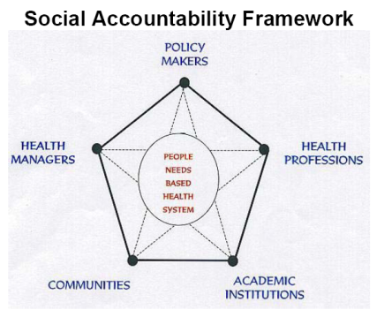

Slide 5

Responsabilité sociale au Canada 2001
AFMC avec Santé Canada (ministère fédéral)

Slide 6
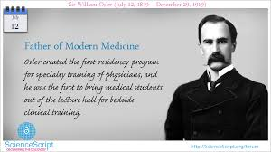
William Osler

Slide 7
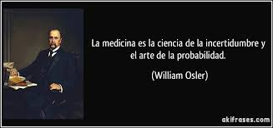
In Spanish!

Slide 8
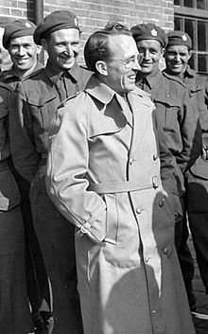
Tommy Douglas- Universal Health Care

Slide 9

Family Medicine as a Specialty

Slide 10
Province of Québec
Too many sub-specialists, not enough family physicians
We cannot afford to train doctors who do not respond to the needs of the population.
Québec government proposes a reversal of the traditional family medicine vs. specialty ratio to obtain, respectively, 55% family physicians and 45% specialists, and that, as of 2017.

Slide 11
Pan Canadian Physician Resource Planning
Physician Resource Planning Advisory Committee
Deputy Minister of Health mandated and funded
Joint venture of the Federal/Provincial/Territorial Committee on Health Workforce (CHW) and the AFMC
Membership also includes representatives from academic medicine including learners
To determine the right number, mix and distribution of physicians to meet societal needs

Slide 12

Pan Canadian Physician Resource Planning
Decisions regarding funding for Medical School and Residency numbers reside with each provincial government

Slide 13
Pan Canadian Physician Resource Planning
3 main areas of work:
  Developing a consultative process for collaboration and coordination to address physician imbalances across identified specialties
  A pan-Canadian physician planning tool to better inform physician supply and need/demand (starting with the supply model)
  Products/fact-sheets that provide accurate information to support decision-making by those considering and currently pursuing medical education, both in Canada and abroad (Future MD Canada tool)

Slide 14
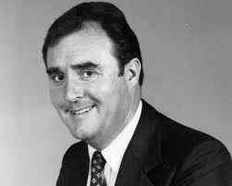
Dr Ian Hart – Father of the OSCE

Slide 15

CanMEDS 2015

Slide 16
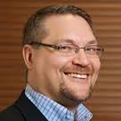
Royal College of Physicians and Surgeons
Dr Jason Frank

Slide 17
CanMEDS 2015
CanMEDS is a framework for physician competency
Work from public consultation in Ontario (AMS)
Original framework released in 1996
Updated with CanMEDS 2005
Enhanced framework – CanMEDS 2015
  Aligned with CBME approach and milestones
  Major change from ‘Manager’ to ‘Leader’ role

Slide 18
CanMEDS 2015 – Leader Role
Describes the engagement of all physicians in shared decision-making for the health care system
Encompasses collaborative leadership and management skills
Leader as team player

Slide 19
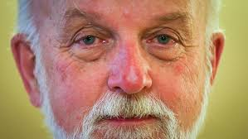
Problem Based Learning (PBL)
Dr Geoff Norman

Slide 20
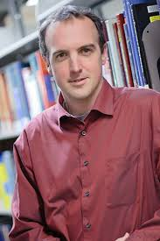
Multiple Mini Interview (MMI)
Dr Kevin Eva

Slide 21
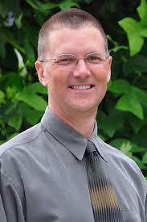
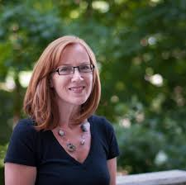
Research in Medical Education
Dr Lorelei Lingard
Dr Glen Regehr

Slide 22
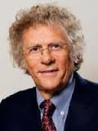
Vision for the Future of Medical Education
Dr Nick Busing,
Past President and CEO, AFMC

Slide 23





www.afmc.ca/fmec/

Slide 24
“The Future of Medical Education in Canada” MD Recommendations
Address Individual and Community Needs
Enhance Admissions Processes
Build on the Scientific Basis of Medicine
Promote Prevention and Public Health
Address the Hidden Curriculum

Slide 25
“The Future of Medical Education in Canada” MD Recommendations
Diversify Learning Contexts
Value Generalism
Advance Inter- and Intra-Professional Practice
Adopt a Competency-Based and Flexible Approach
Foster Medical Leadership

Slide 26

Enabling Recommendations
I: Re-Align Accreditation Standards
II: Build Capacity for Change
III: Increase National Collaboration
IV: Increase the Intelligent Use of Technology
V: Enhance Faculty Development
Notes:
26

Slide 27




Slide 28
Four consortium partners
Association of Faculties of Medicine of Canada (AFMC)
College of Family Physicians of Canada (CFPC)
Collège des médecins du Québec (CMQ)
Royal College of Physicians and Surgeons of Canada (Royal College)

Slide 29
FMEC PG Recommendations
Rec 1: Ensure the Right Mix, Distribution, and Number of Physicians to Meet Societal Needs
Rec 2: Cultivate Social Accountability through Experience in Diverse Learning and Work Environments
Rec 3: Create Positive and Supportive Learning and Work Environments
Rec 4: Integrate Competency-Based Curricula in Postgraduate Programs
Rec 5: Ensure Effective Integration and Transitions along the Educational Continuum

Slide 30
FMEC PG Recommendations
Rec 6: Implement Effective Assessment Systems
Rec 7: Develop, Support, and Recognize Clinical Teachers
Rec 8: Foster Leadership Development
Rec 9: Establish Effective Collaborative Governance in PGME
Rec 10: Align Accreditation Standards

Slide 31

Arose out of FMEC PG Recommendation #9
Membership includes senior leaders from major Canadian medical education organizations, learner groups, government and a public member
Mandate: Integrates the multiple PGME stakeholders to work collaboratively to achieve efficiency, reduce redundancy and provide clarity on strategic directions and decisions for PGME in the best interest of society, learners and the health system

Slide 32
Accreditation Alignment
Canadian accrediting bodies have agreed to a common domain framework for their accreditation standards
Other initiatives include aligning language, terminology and commonly used accreditation forms
Data requirements across organizations and a shared Accreditation Management System (AMS)
New accreditation standards are striving to find the right balance between processes and outcomes

Slide 33
A Canadian Consensus on Core Competencies for Transition from Medical School to Residency
V International Congress of Medical Education
June 2016 – Cancun, Mexico
Dr. Geneviève Moineau, President and CEO,
Association of Faculties of Medicine of Canada

Slide 34


Slide 35
Why EPAs at the transition?
Ensures that students have been observed performing the necessary core activities prior to beginning residency training
Ensures that residents will be ready to perform certain core activities on Day 1 of residency training

Slide 36
AFMC EPAs
EPA = Entrustable Professional Activities
Set of core skills expected of every medical student upon graduation
  Regardless of MD school, residency training program site or chosen specialty
Pan-Canadian list derived from 13 AAMC EPAs
  Adapted for a Canadian context
  Landed on 12 Canadian EPAs
Working Group led by Andrée Boucher (AFMC) and Claire Touchie (MCC)

Slide 37
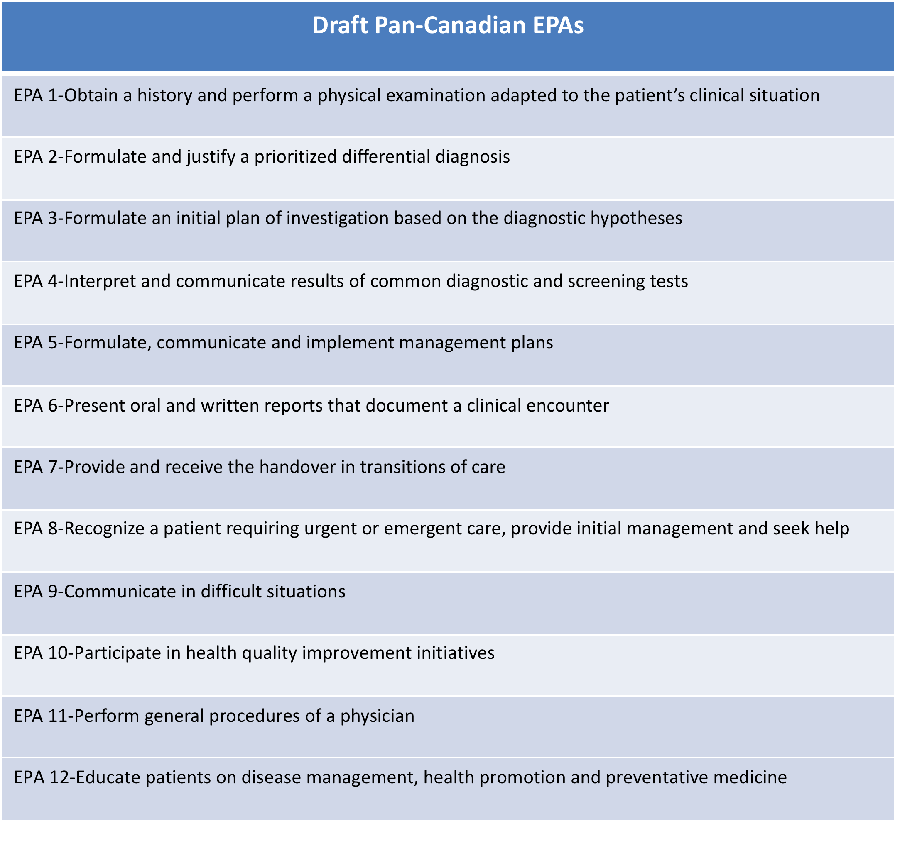
AFMC EPAs

Slide 38
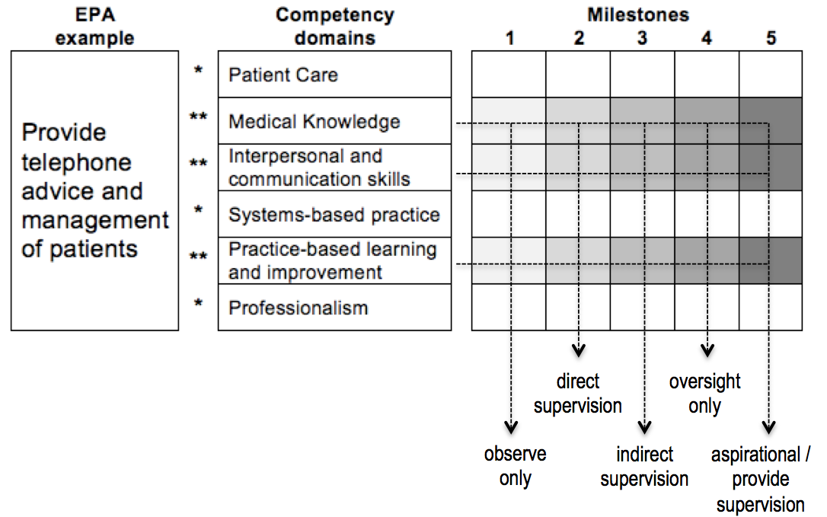
CBME, EPAs and Milestones -
How do they all relate?
  EPAs: what we do
  Competencies: KSAs we need to be competent – person-descriptors
  Milestones (observable behaviours) : how we get there
Ten Cate et al., Med Teach AMEE guide 99, 2015

Slide 39
FMEC CPD
Third FMEC project, looking at Continuing Professional Development (CPD)
VISION: A CPD system that sustains innovation and ongoing quality improvement for the health of Canadians
STRATEGY: Use a collaborative process to define the policies, structures and mechanisms that will enable the future CPD system

Slide 40
FMEC-CPD PARTNER ORGANIZATIONS
Royal College of Physicians and Surgeons of Canada
The Association of Faculties of Medicine of Canada
Medical Council of Canada
Canadian Medical Association
The College of Family Physicians of Canada
Canadian Medical Protective Association
Federation of Medical Regulatory Authorities of Canada
7 Funding Partners
Project Secretariat Formed / Project Launched May 2015

Slide 41
FMEC CPD
Priority (Some Projects Align with Multiple Themes) | # of Projects Aligned with Priority
Priority #1: Federation of Medical Regulatory Authorities of Canada (FMRAC) Physician Practice Improvement Principles and Roles | 16 Projects
Priority #2: CPD as Contributors to Addressing Issues of Importance to the Health of Canadians | 12 Projects
Priority #3: Meaning and Implications of “Scope of Practice” for Individual Physicians Related to Personal CPD | 11 Projects
Priority #4: Funding Model(s) for Continuing Professional Development | 7 Projects
Priority #5: CPD as Part of the Lifelong Learning Continuum for physicians | 18 Projects
Priority #6: Advancement of Competency Based CPD | 20 Projects
Priority #7: Competencies Required by Individuals to Develop and Deliver CPD | 9 Projects
Priority #8: Interprofessional Teams as Audience for CPD | 3 Projects

Slide 42
Just Really Lucky
Universal Health Care System
Publically Funded Medical Education System
All residency programs University based
Reasonable number of medical schools and organizations
Nice people who usually want to collaborate
Lots of friendly neighbors willing to help
And now a government who seems to care

Slide 43
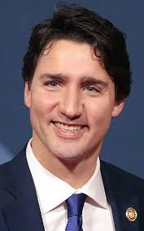
The Future Looks Bright

Slide 44
Conclusion
Questions/Comments?

