Slide 1
Quality and Quantity: managing medical education in a rapidly changing world
David Gordon
World Federation for Medical Education

Slide 2
Quantity – how many medical schools and how many students? Are the numbers what we actually need?
Quality – are those schools and those students as good as they should be?

Slide 3


“... the strangest of books ... not a romance, a pastoral drama or an adventure story about an outlaw ... but the story of a man who had read so many books like these that he believed they were true”
We have a similar problem: what is real and what is fantasy about medical school and student numbers and quality of education, and how do we find out the facts?

Slide 4
Structure of this talk
What is the World Federation for Medical Education?
What did we know about medical school numbers, what do we know now, and what do we not know (“grow like mushrooms” - often delicious but sometime poisonous)?
Ways to understand quality in medical education: standards; accreditation; recognition of accreditation

Slide 5
What is WFME?
What does it do?
A partnership organisation for the world’s regional associations for medical education, also working with other major partners: WHO, WMA, IFMSA, ECFMG. The NGO for medical education in official relation with WHO.
Three WFME programmes in the last 15 years
  Standards for medical education
  Accreditation and Recognition of Accrediting Agencies
  Essential databases – World list of medical schools
  WFME is not primarily concerned with the detail of education: of how medicine is taught. Our concern is with the quality, management, organisation, support and delivery of medical education.
  Head office in Ferney-Voltaire, France, near Geneva
  http//wfme.org/ http//wdoms.org

Slide 6
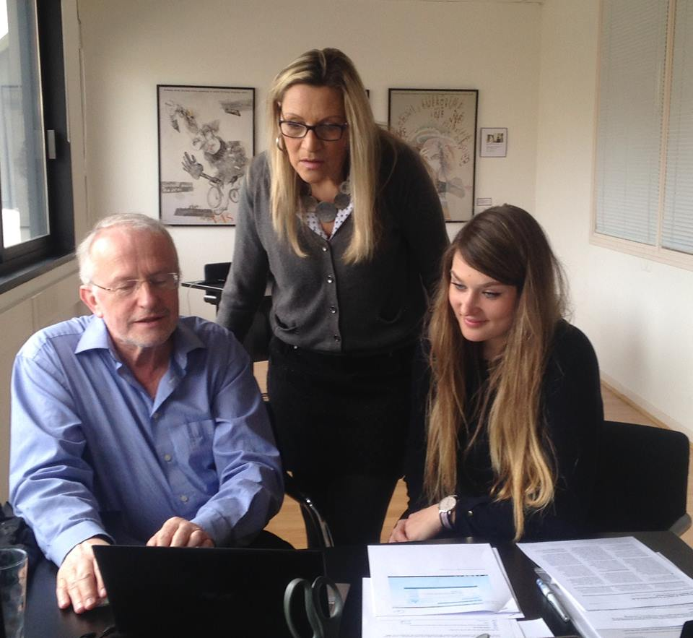
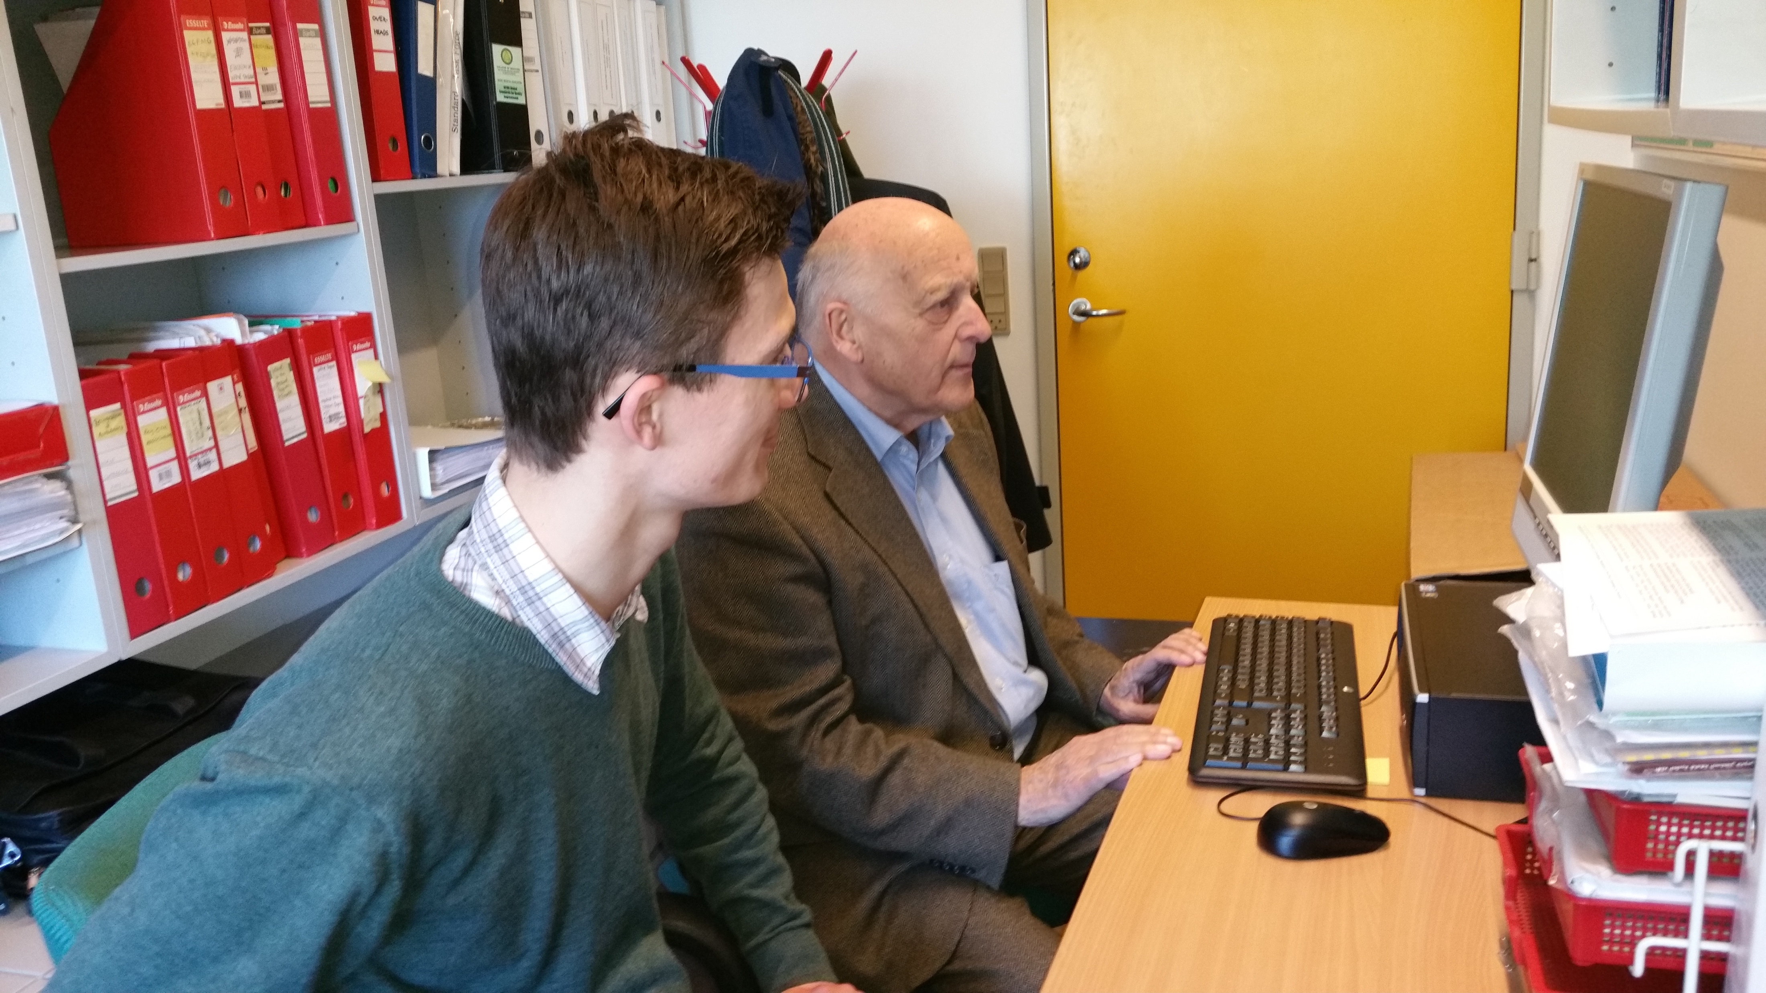

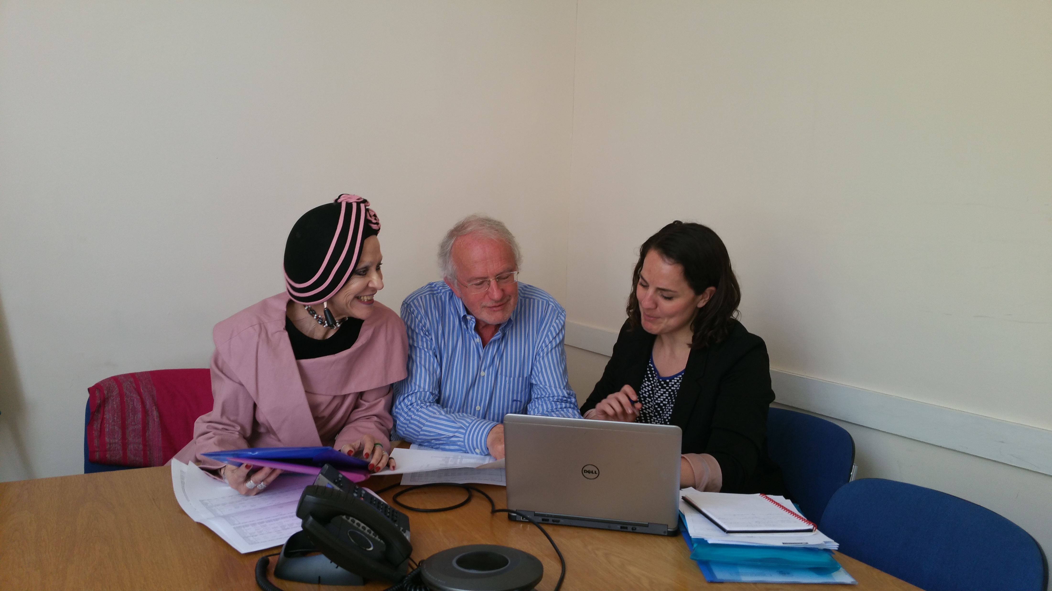

Slide 7



Quantity – numbers, of medical schools and of students
New medical schools can “grow like mushrooms”
How do you get interested in:
  Medical school numbers?
  Mushrooms?

Slide 8


Interested in medical school numbers?

Slide 9
The Avicenna Project
Managed by WFME, “Avicenna” was the successor to the WHO World Directory of Medical Schools (1953 – 2000)
Directories of educational institutions for the academic health professions, particularly medicine
Now merged with IMED (FAIMER©) to make the new World Directory of Medical Schools (http://www.wdoms.org/)

Slide 10
World Directory of Medical Schools
Managed jointly by WFME and FAIMER
“It is the mission of the World Directory of Medical Schools to list all of the medical schools in the world, with accurate, up-to-date, and comprehensive information on each school.”
The school must exist: and be recognised by the national government or other competent authority (+ other requirements)
“… does not denote … accreditation or endorsement …”

Slide 11
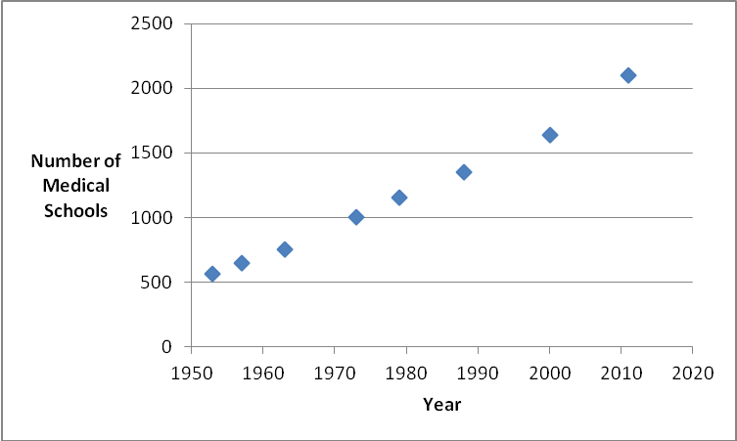
The global picture …

Slide 12


Slide 13
School numbers within one region when you look them up

Slide 14
School numbers in the same region when you ask …

Slide 15
How to make WDMS more complete, and solve the “600 schools” problem?
Slowly – schools completing the application form
Faster – country-wide surveys using trusted local contacts
    Indonesia, Turkey, Georgia, Bangladesh, Russia, etc. (mostly good mushrooms….)
But – the problem is not just whether the schools exist: it is also “are they of suitable standard?”

Slide 16

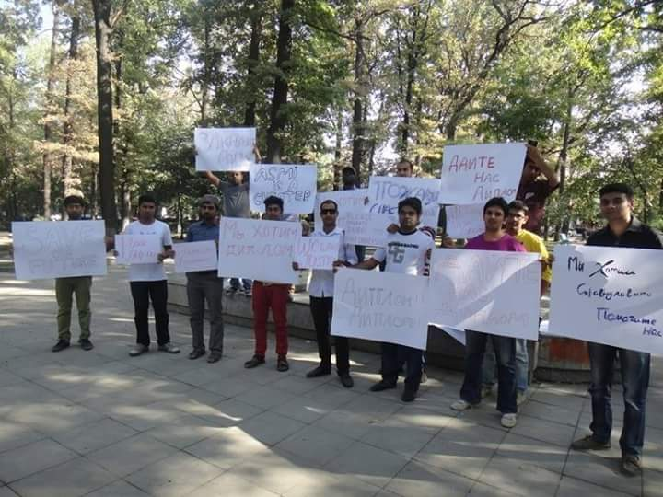
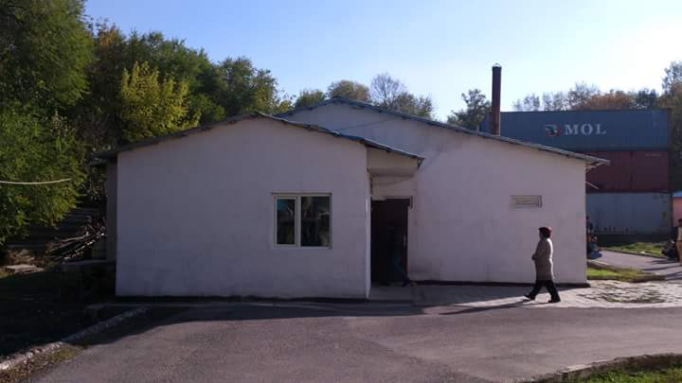
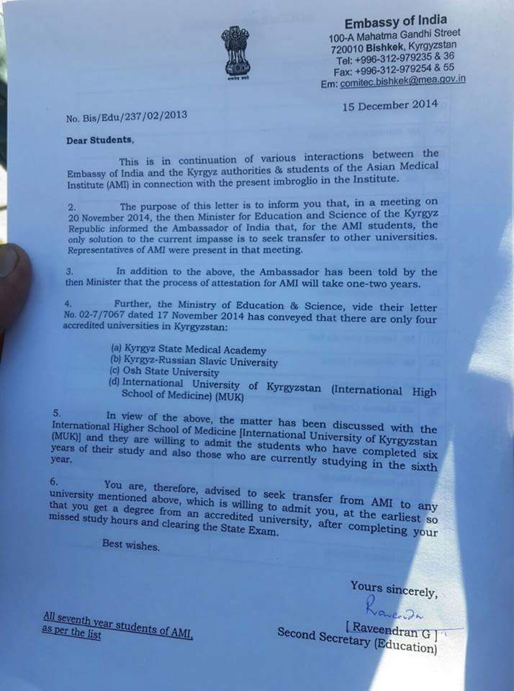

Schools that are in WDMS, have to be there, but ...

Slide 17
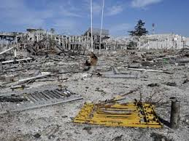
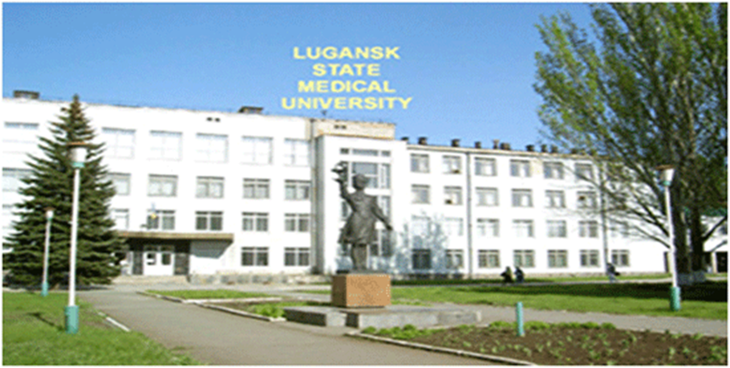

Slide 18
How have previous episodes of overgrowth been controlled?
United Kingdom
  Including ….
  1518 – Royal College of Physicians of London
  Medical Act of 1858 "it is expedient that Persons requiring Medical Aid should be enabled to distinguish qualified from unqualified Practitioners“
  Many poor-quality medical schools closed

Slide 19
… previous episodes of overgrowth (2)
United States of America
Why was the Flexner report largely implemented? (Beck, 2004)
  State medical boards
  The profession (AMA)
  Philanthropy

Slide 20
Quality – are new schools good enough? Are old schools keeping up?
Ways to understand quality in medical education: standards; accreditation; recognition of accreditation

Slide 21
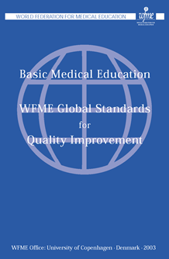
WFME Standards for medical education
Origin, outcome and future
“The purpose [of the standards programme] is to provide a mechanism for quality improvement in medical education, in a global context, to be applied by institutions, organisations and national authorities responsible for medical education”
- thus, not what should be taught and learned, but more, at what standard should it be taught, and to what standard it should it be learned?
Outcomes? – many, but in particular, help to develop accreditation
Future? – an emphasis on practicality, and on interdisciplinary development

Slide 22
“IMPORTANT: An Explanatory Note to guide the use of these Standards”
These standards are based on our current understanding of fundamental principles and best practices in designing, maintaining, and enhancing medical education programmes
Standards are intended to guide medical education programme development and evaluation, facilitate diagnosis of strengths and weaknesses relating to the medical education programme, and to stimulate quality improvement
Each institution or regulator should review the relevant standards and develop a version of them that is appropriate to the local context. It would be helpful if those local, contextual standards are mapped on to the original WFME standards
Not all standards may have application in every setting
A medical school may well receive a satisfactory overall evaluation and maintain accreditation (where appropriate) without necessarily meeting every standard and sub-standard

Slide 23
These standards are based on our current understanding of fundamental principles and best practices in designing, maintaining, and enhancing medical education programmes
Standards are intended to guide medical education programme development and evaluation, facilitate diagnosis of strengths and weaknesses relating to the medical education programme, and to stimulate quality improvement
Each institution or regulator should Review the relevant standards and develop a version of them that is appropriate to the local context. It would be helpful if those local, contextual standards are mapped on to the original WFME standards
Not all standards may have application in every setting
A medical school may well receive a satisfactory overall evaluation and maintain accreditation (where appropriate) without necessarily meeting every standard and sub-standard

Slide 24
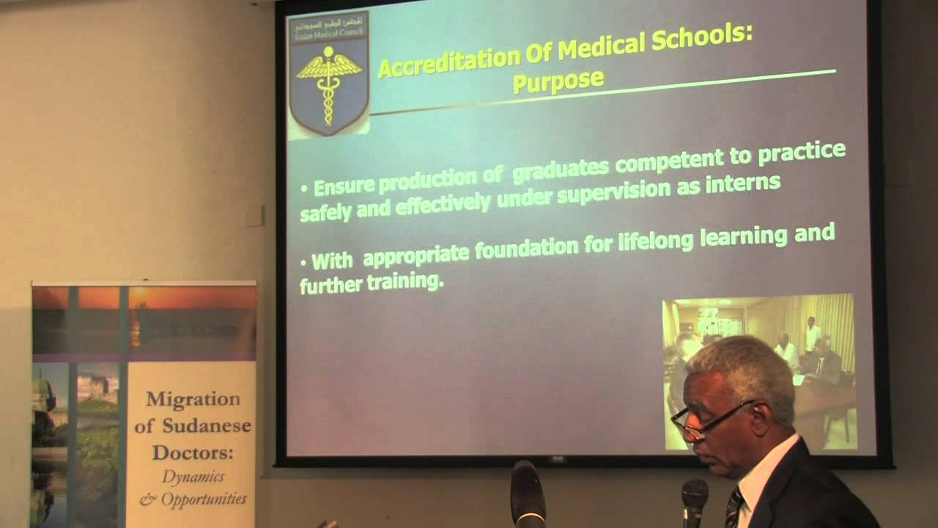

Slide 25

Accreditation
Use of standards to support accreditation
“The accreditation of medical education – certification of the suitability of medical education programmes, and of the competence of medical schools in the delivery of medical education – is of the highest importance”
http://www.wfme.org/accreditation/whowfme-policy
What is practical?

Slide 26

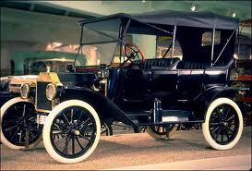



Slide 27
Reasons for accreditation (1)
The main reason is to enhance the quality of medical education, by verifying that medical schools are competent in the delivery of medical education, and that medical education programmes are suitable. This is to ensure that medical schools are educating doctors fit to serve the needs of the population where they function

Slide 28
Reasons for accreditation (2)
A secondary reason is to demonstrate to outside organisations and territories that the medical schools accredited are competent, and producing doctors at an accepted international standard

Slide 29
Reasons for accreditation (3)
An additional reason – but should be much less important than the other two – is to meet the 2023 deadline set by ECFMG. Although this is a secondary reason for introducing accreditation, it is a powerful stimulus
“...effective in 2023, physicians applying for ECFMG Certification will be required to graduate from a medical school that has been appropriately accredited. To satisfy this requirement, the physician’s medical school must be accredited through a formal process that uses criteria comparable to those established for U.S. medical schools by the Liaison Committee on Medical Education (LCME) or that uses other globally accepted criteria, such as those put forth by the World Federation for Medical Education (WFME)”

Slide 30
Does accreditation enhance quality in medical education?
There is some evidence
  van Zanten and Boulet (2013, Quality in Higher Education, 19:3, 283-299)
History cannot be ignored
We should not berate ourselves for lack of evidence of the benefits of accreditation
  There is a lack of evidence for most activities in medical education
We must work to examine if there really is more good new evidence
  This region has the potential to be a resource of “good new evidence”

Slide 31
Requirements for accreditation
The accreditation system must:
Be agreed by all relevant parties (medical schools, students, the profession, the health care system and the public), be trusted, and be transparent
Be operating within a suitable legal framework and supported by national law*

Slide 32
Requirements for accreditation (2)
The accreditation system must:
3. Have a suitable organisational structure, governance, management and operation, and be medicine-specific*
4. Work to predetermined, agreed and publicly available standards* and criteria

Slide 33
Requirements for accreditation (3)
The accreditation system must:
5. Work using internationally acceptable processes, including self-assessment, and site visits
6. Publish its decisions

Slide 34
“… suitable legal framework and supported by national law”?
“… be medicine-specific”?
“… predetermined, agreed and publicly available standards”?

Slide 35
  WFME Recognition Process
  Accrediting agency (must be medicine-specific) contacts WFME to determine eligibility - accreditation@wfme.org
  Accrediting agency completes the Application for Recognition - http://www.wfme.org/accreditation
  Correspondence with WFME to ensure Application is complete
  Timeline for site visit(s) established

Slide 36
  WFME Recognition Process
  5. WFME Recognition Team observes accrediting agency
    conducting a site visit of one medical school
    meeting to make accreditation decision
  6. Recognition Report describing the accrediting agency’s compliance with the Recognition Criteria
  7. Quality improvement recommendations
  8. WFME Recognition Committee makes decision on recognition of accrediting agency

Slide 37
International developments in standards and accreditation in medical education
Wider acceptance of the need for (context-specific) standards for medical education
Vigorous local development of standards and mechanisms for accreditation
Rapidly developing interest in international recognition of accreditation (Caribbean, North America, Turkey, Korea, Australia, Japan, Iran, Egypt, Iraq, Taiwan, Kazakhstan, etc., etc. ……)

Slide 38
In conclusion …
“… what is real and what is fantasy about medical school and student numbers and quality of education”
  We know the facts about thousands of medical schools that exist: but for some hundreds, we do not know
  We have very little data to link student numbers to medical school numbers
  Our data about the quality of education are excellent in many parts of the world: and non-existent in many others

Slide 39

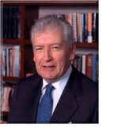

“It is not true that people stop pursuing dreams because they grow old, they grow old because they stop pursuing dreams.”
Gabriel Garcí­a Márquez

Slide 40

Men who are occupied in the restoration of health to other men, by the joint exertion of skill and humanity, are above all the great of the earth. They even partake of divinity, since to preserve and renew is almost as noble as to create.
Voltaire, 1694 – 30 May 1778

